Slide 1
Modified Communication Parallel Compact Firefly Algorithm and Its Application
Geng-Chen Li

Slide 2
CONTENT
01
02
03
04
05
Part one
Part two
Part three
Part four
Part five
Introduction
MCPCFA
Test Experiments
3D 0-1 Model of WSN
Applacation of MCPCFA in WSN 3D Coverage Optimization

Slide 3
PART 1
Introduction

Slide 4
PART 1 Introduction
Swarm intelligence algorithm is an optimization method proposed by researchers based on the research of biological group behavior and physical phenomena in nature.
Internet of things and big data are hot research and appli_x0002_cation fields in the intelligent era. As the core infrastructure of Internet of things and big data, WSN have been widely studied and deeply developed in recent years.
In this paper, our goal is to analyze the shortcomings of FA and make corresponding improvements, so as to improve the performance of the algorithm.
Using the improved version of FA proposed in this paper, MCPCFA family algorithm optimizes the node deployment strategy of WSN and finds the node layout mode with the maximum coverage.

Slide 5
PART 1 Introduction
The main contributions of this paper are summarized as follows.
MCPFA family algorithm is proposed, and the population number of MCPFA is updated to further improve the performance of FA.
The performance of the proposed MCPFA is analyzed. In order to use less memory to simulate the operation of MCPFA, the compact idea is added, and the MCPCFA is proposed to improve the overall function of FA.
In this paper, CEC2013 test function set is used to test and analyze the performance of the proposed MCPCFA fam_x0002_ily algorithm, which verifies our theory. The data results show that compared with other comparison algorithms, MCPCFA shows strong ability.
This paper introduces the traditional WSN coverage model, 0-1 model. At the same time, MCPCFA family algorithm was used to optimize the model. Through the analysis of simulation results, it is confirmed that the optimization ability of the proposed method is better than other methods. The superiority and applicability of MCPCFA in this field are also verified.

Slide 6
PART 2
Modified Communication Parallel Compact Firefly Algorithm

Slide 7


PART 2 Modified Communication Parallel Compact Firefly Algorithm
A. Firefly Algorithm

Slide 8
PART 2 Modified Communication Parallel Compact Firefly Algorithm
B. Modified Communication Parallel Firefly Algorithm
Although the traditional FA has stronger global search ability than other algorithms, like most swarm intelligence algorithm, FA still has the disadvantage that it is easy to fall into the local optimal solution, resulting in the premature convergence of the algorithm in the running process. Therefore, aiming at this problem, based on the traditional parallel strategy, this paper proposes MCPFA family algorithm.
Communication strategy in the first stage:
Modified Communication Parallel Firefly Algorithm-Best (MCPFA-B)
Modified Communication Parallel Firefly Algorithm Average (MCPFA-A)
Modified Communication Parallel Firefly Algorithm Rand (MCPFA-R)

Slide 9
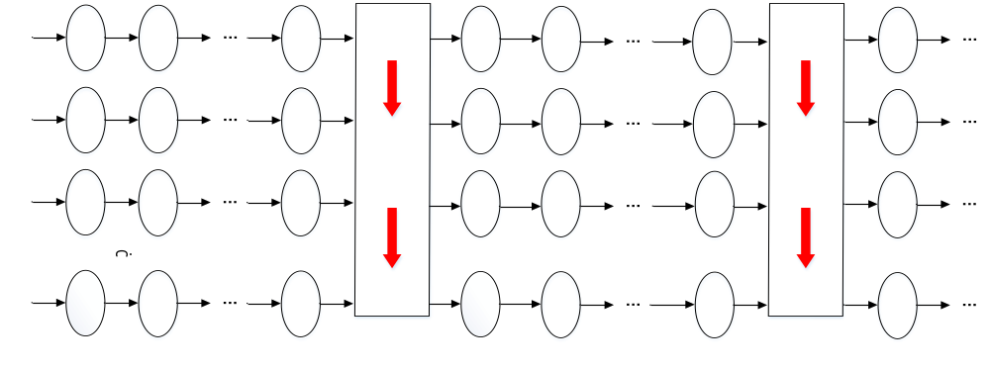
PART 2 Modified Communication Parallel Compact Firefly Algorithm
Modified Communication Parallel Firefly Algorithm-Best (MCPFA-B)

Slide 10
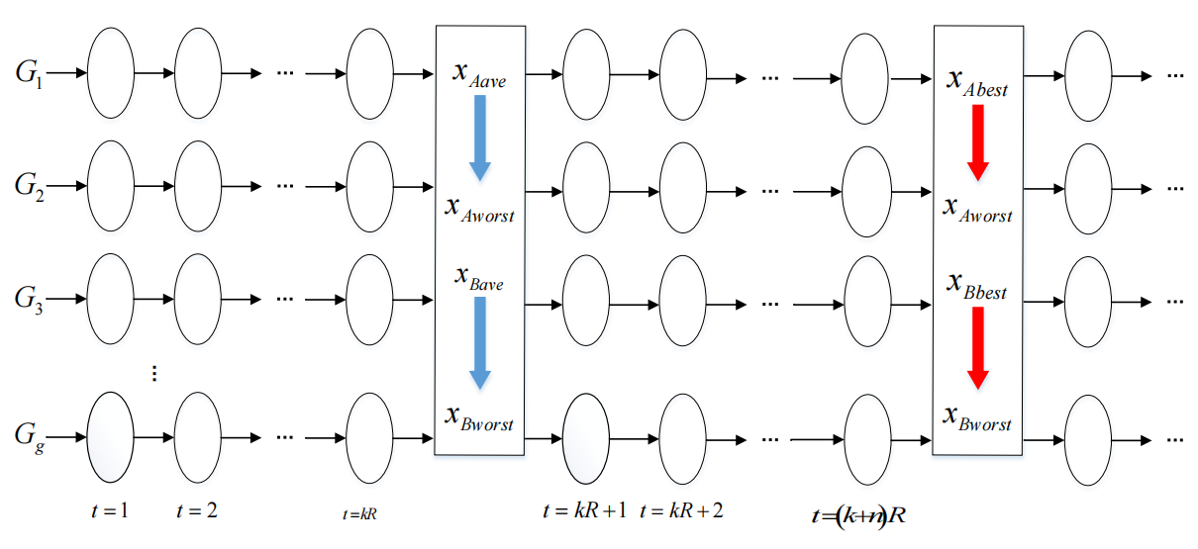
PART 2 Modified Communication Parallel Compact Firefly Algorithm
Modified Communication Parallel Firefly Algorithm Average (MCPFA-A)

Slide 11
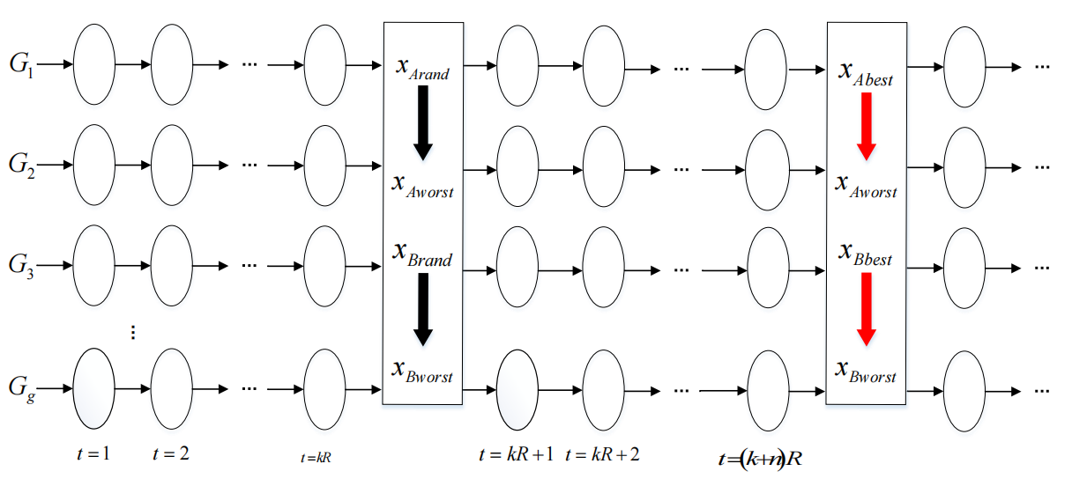
PART 2 Modified Communication Parallel Compact Firefly Algorithm
Modified Communication Parallel Firefly Algorithm-Best (MCPFA-B)

Slide 12
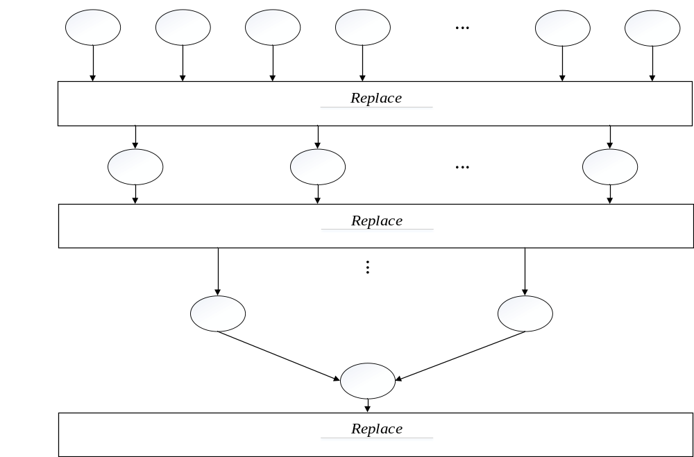
PART 2 Modified Communication Parallel Compact Firefly Algorithm
Communication strategy in the second stage:

Slide 13

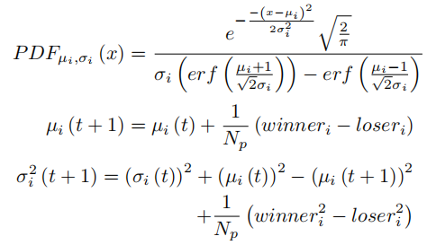
PART 2 Modified Communication Parallel Compact Firefly Algorithm
C. Compact optimization method
Finally, the time complexity of MCPCFA is theoretically analyzed to better introduce the MCPCFA algorithm proposed in this paper. the time complexity of the compression strategy FA is O(g×d), the time complexity of updating the optimal value is O(1), and the time complexity of the FA algorithm using the parallel strategy is O(g×g). So the above calcula_x0002_tion complexity is max(O(g×d), O(1), O(g×g))=O(g×d), std. d>g. The computational complexity of the entire algorithm is O(timemax×g×d), that is, the time complexity of MCPCFA is O(timemax×g×d).

Slide 14
PART 3
Test Experiments of MCPCFA Family Algorithm

Slide 15
PART 3 Test Experiments of MCPCFA Family Algorithm
In order to verify the advantages of MCPCFA family algorithm proposed in this paper, several classical test functions from CEC2013 test function set will be used to test the performance of the algorithm in MATLAB2015b. At the same time, comparative experiments were carried out with PSO, FA, PFA and CFA. In order to ensure the fairness of the experimental results, the parameter settings of each algorithm will be set uniformly. Each test function will be run 30 times and the results will be averaged and compared. The population number of all algorithms is set to 80 and the maximum number of iterations itermax is set to 1000. In PFA and MCPCFA family algorithm, the population was divided into 8 groups. In addition, make all teams exchange information every 20 iterations.
CEC2013 test function set includes Unimodal Functions, Basic Multimodal Functions and Composition Functions. We select two classical test functions from each category to test the performance of the algorithm.

Slide 16
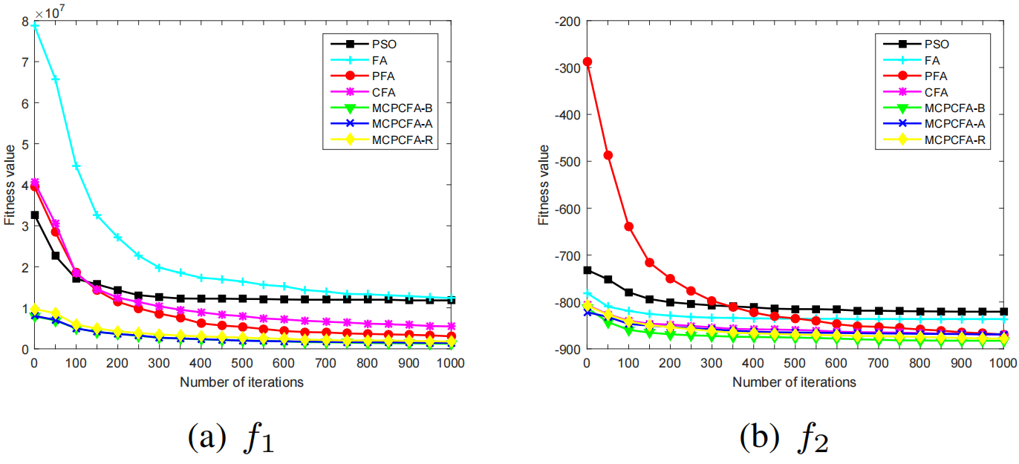
PART 3 Test Experiments of MCPCFA Family Algorithm

Slide 17
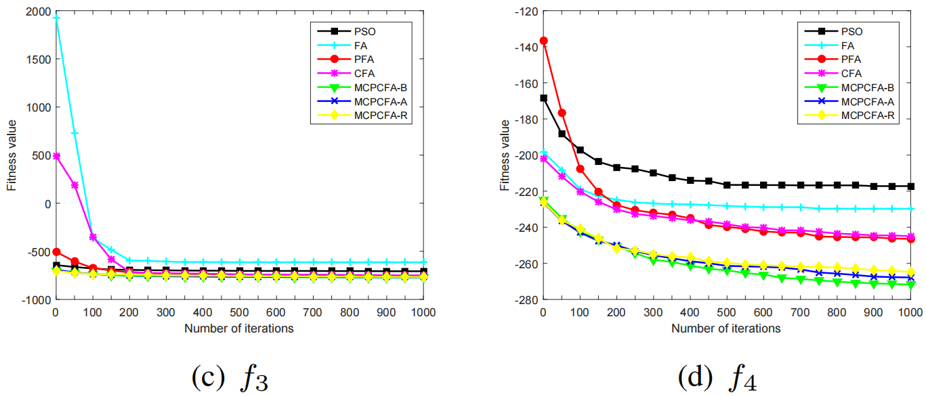
PART 3 Test Experiments of MCPCFA Family Algorithm

Slide 18
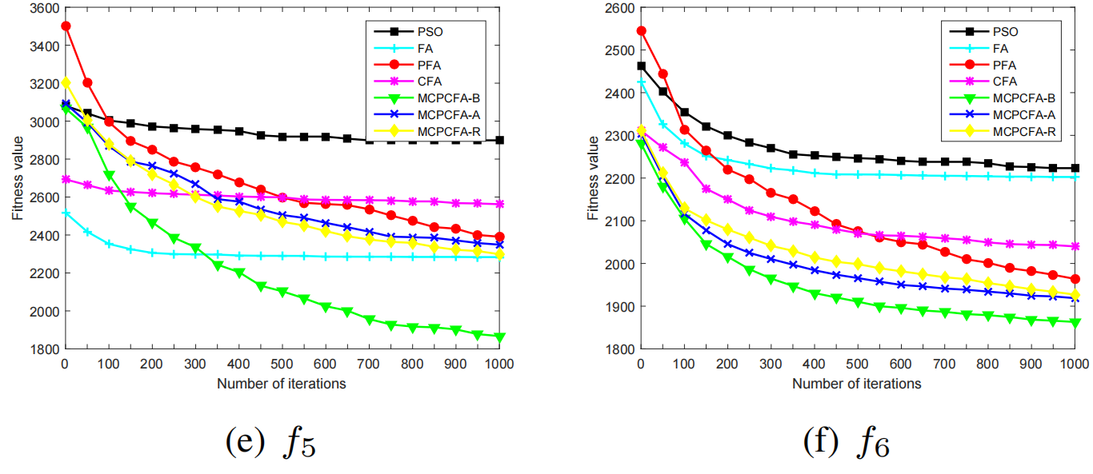
PART 3 Test Experiments of MCPCFA Family Algorithm

Slide 19
PART 4
3D 0-1 Coverage Model of WSN

Slide 20


PART 4 3D 0-1 Coverage Model of WSN
The node deployment problem of WSN is necessary. The traditional coverage problem is usually studied based on 2D plane, but if the sensor nodes are placed on 2D plane, the simulation experiment will be obviously different from the actual situation. Therefore, in this study, the sensor nodes are placed on the 3D terrain, and the terrain elements such as high and low-lying are added to the three-dimensional terrain, so as to more truly simulate the actual coverage problem. To sum up, the 3D 0-1 model and the terrain model proposed in this study will be described in detail below.

Slide 21
Applacation of MCPCFA in WSN 3D Coverage Optimization
PART 5

Slide 22

PART 5 Applacation of MCPCFA in WSN 3D Coverage Optimization
To solve the coverage problem is essentially to find the optimal deployment strategy. Different strategies have a significant impact on coverage, especially on 3D terrain. By optimizing the parameters of FA, using modified parallel strategy and introducing compact idea, this paper proposes MCPCFA family algorithm to improve the performance of FA. MCPCFA family algorithm performs well in solving basic multimodal functions, and the 0-1 coverage of WSN belongs to this kind of problem. Therefore, the 0-1 coverage problem of WSN is effectively solved by the MCPCFA family algorithm.
The sensor node is set on the ground, so you only need to know the two coordinate values of a point to calculate the coordinates of the point. Therefore, the algorithm can optimize the deployment strategy by optimizing the location of any 2D sensor nodes. Each particle of the algorithm represents a deployment strategy.

Slide 23
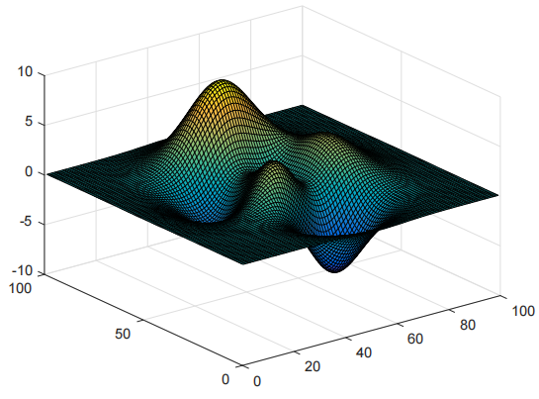
PART 5 Applacation of MCPCFA in WSN 3D Coverage Optimization

Slide 24
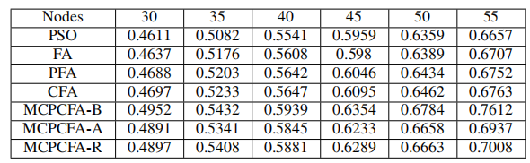
PART 5 Applacation of MCPCFA in WSN 3D Coverage Optimization
A. Simulation experiment when the total number of sensor nodes is different

Slide 25
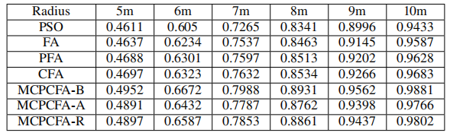
PART 5 Applacation of MCPCFA in WSN 3D Coverage Optimization
B. Simulation experiment with different communication radius

Slide 26

END
THANK YOU

