Slide 1
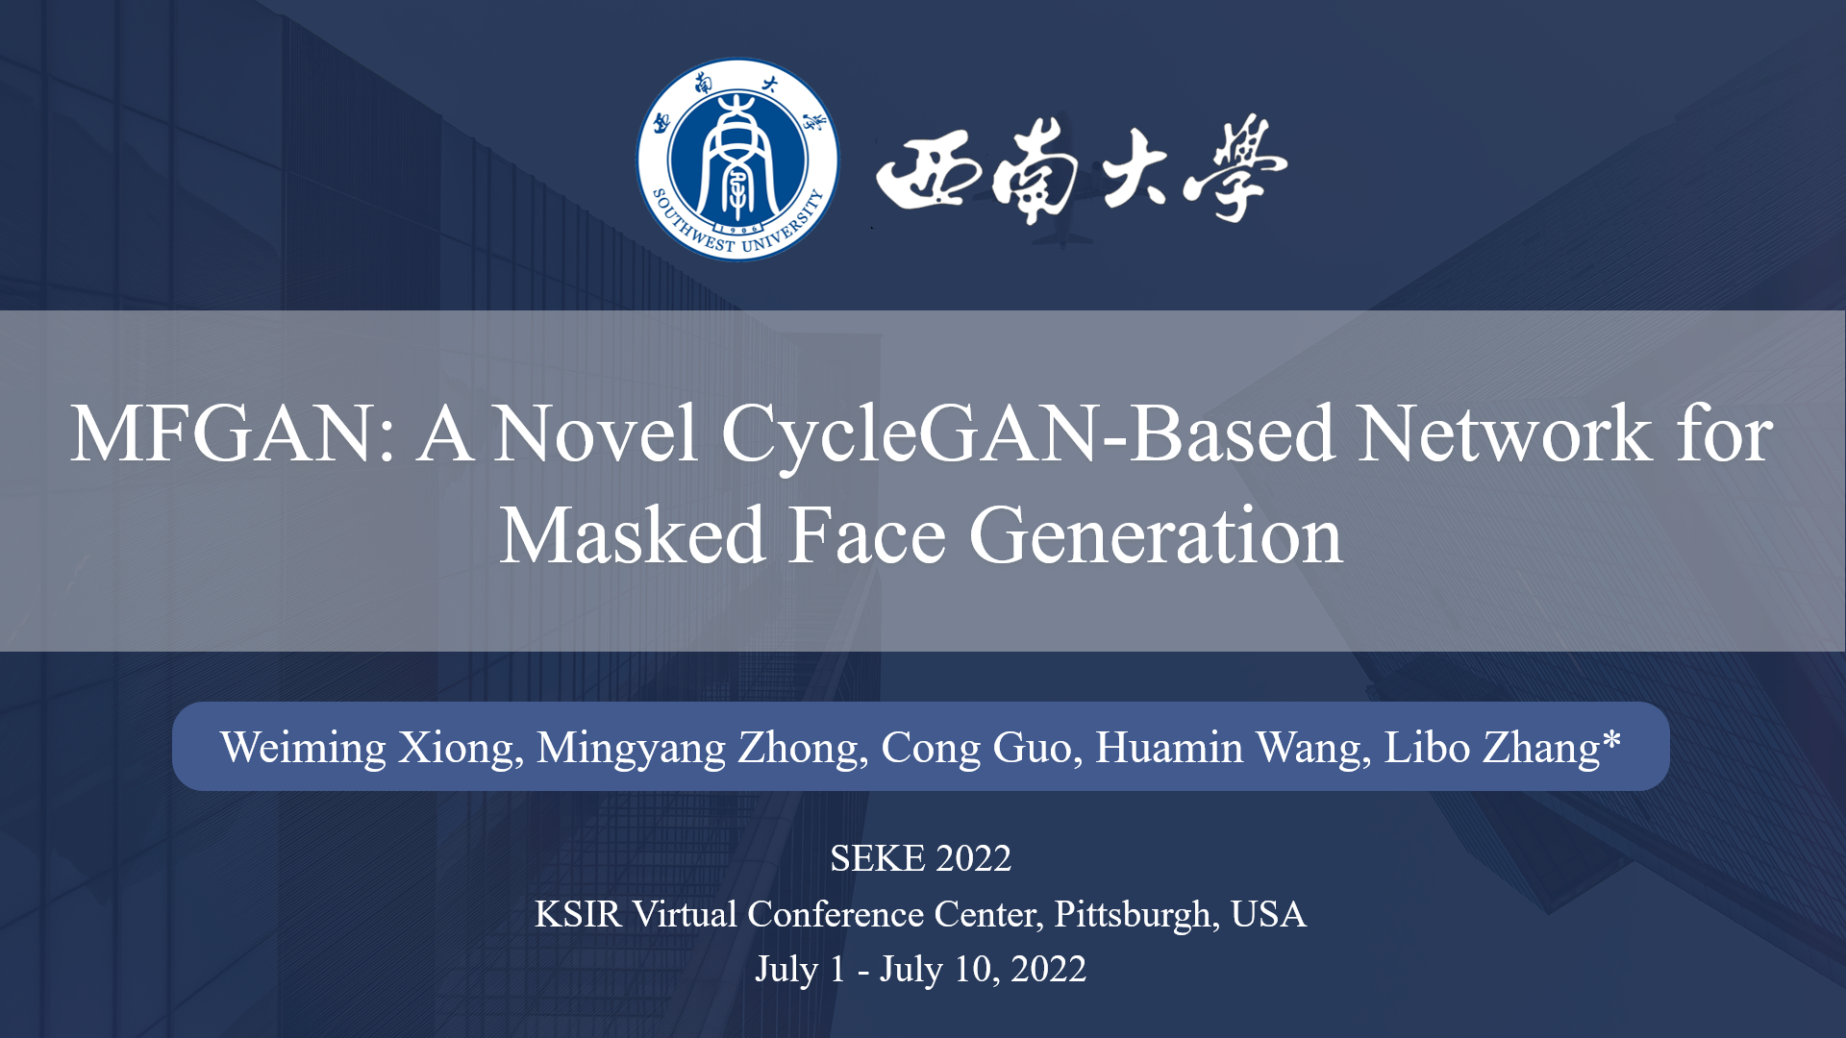

Slide 2
Abstract
Background
In the post-epidemic era, Masked Face Recognition (MFR) is significant.
Problem
Lacking real-world large-scale masked face datasets with identity labels.
Difficulty
Mask enhances the diversity of face images and further improves the requirements for datasets.
Solution
CycleGAN-based masked face generation method MaskedFaceGAN (MFGAN).
Effect
Generate correct, authentic-looking and type-diverse masked face while ensuring the invariance of facial features.
Optimization
Three-stage training pipeline, a facial feature detector, a mask binary segmentation module and a mask style encoder.
Experiments
The experiments of qualitative and quantitative comparison and MFR model training effect comparison.

Slide 3
Contents
DSML: Distributed Systems and Machine Learning
01
Introduction
02
Method
03
Experiments
04
Conclusions

Slide 4
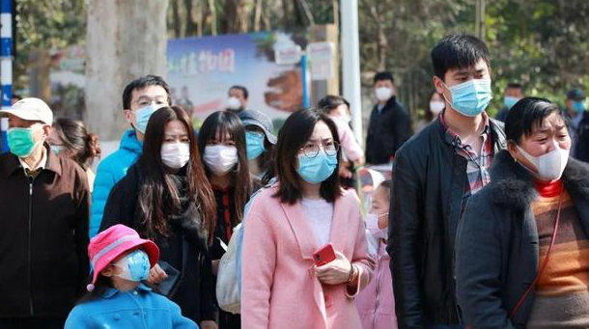
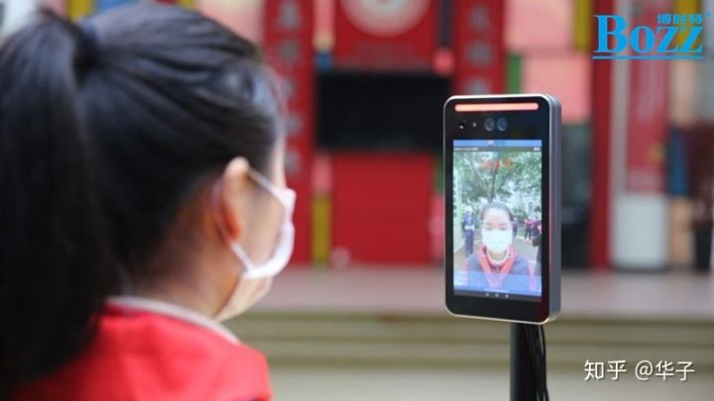
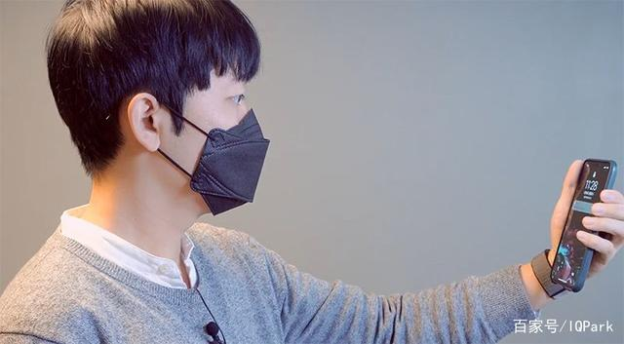
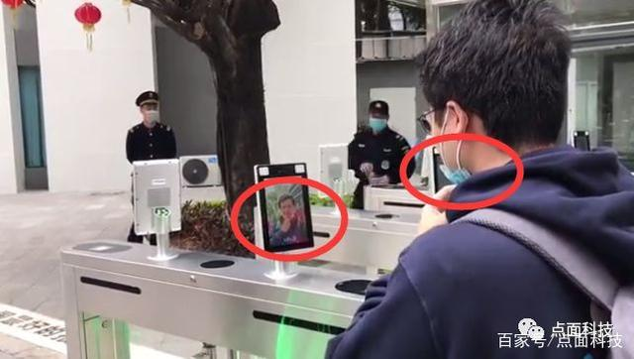
Introduction
MFR: An urgent topic to research
COVID-19
People wear masks for self-protection.
Problem
Face recognition system suffers from performance degradation when confronted with masked face.
MFR
Masked face recognition (MFR) is an urgent topic to research.
√
×
Contradiction
Taking off the mask will increase the risk of infection.
Introduction
Method
Experiments
Conclusions
1

Slide 5
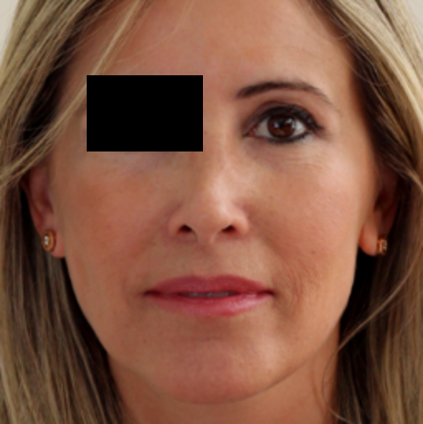
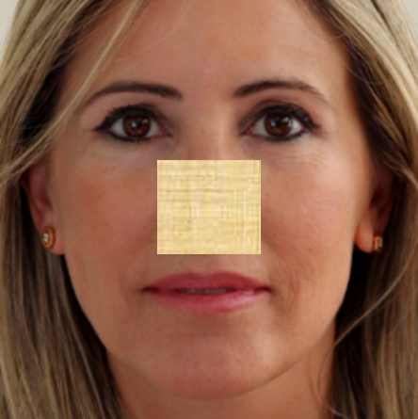
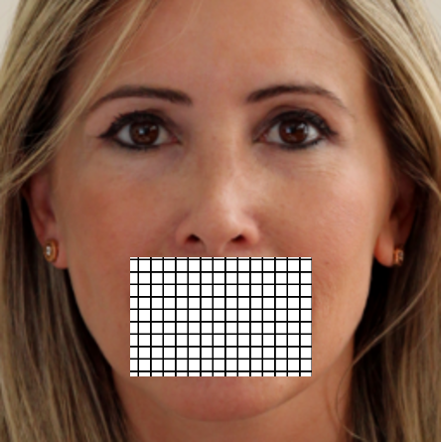
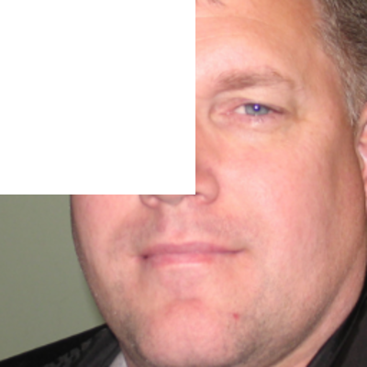

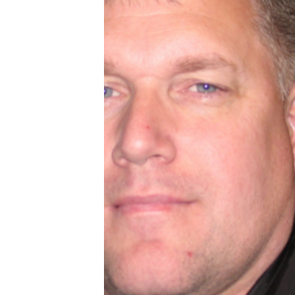
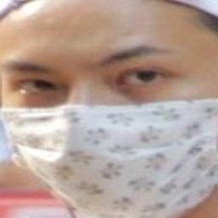
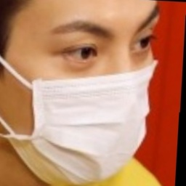
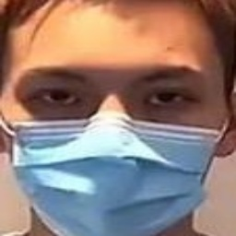
Introduction
MFR: A new problem encountered
Occlusion Robust Face Recognition (OFR)
It is suitable for face recognition with random occlusion in small areas.
Occluded Faces
Partial Face Recognition (PFR)
The integrity of the face contour is not considered.
Partial Faces
Masked Face Recognition (MFR)
Mask occlusion is a kind of fixed position, large area, continuous and diverse occlusion.
Masked Faces
Introduction
Method
Experiments
Conclusions
2

Slide 6
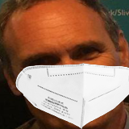
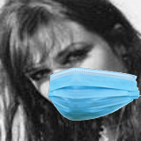
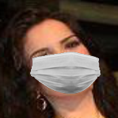
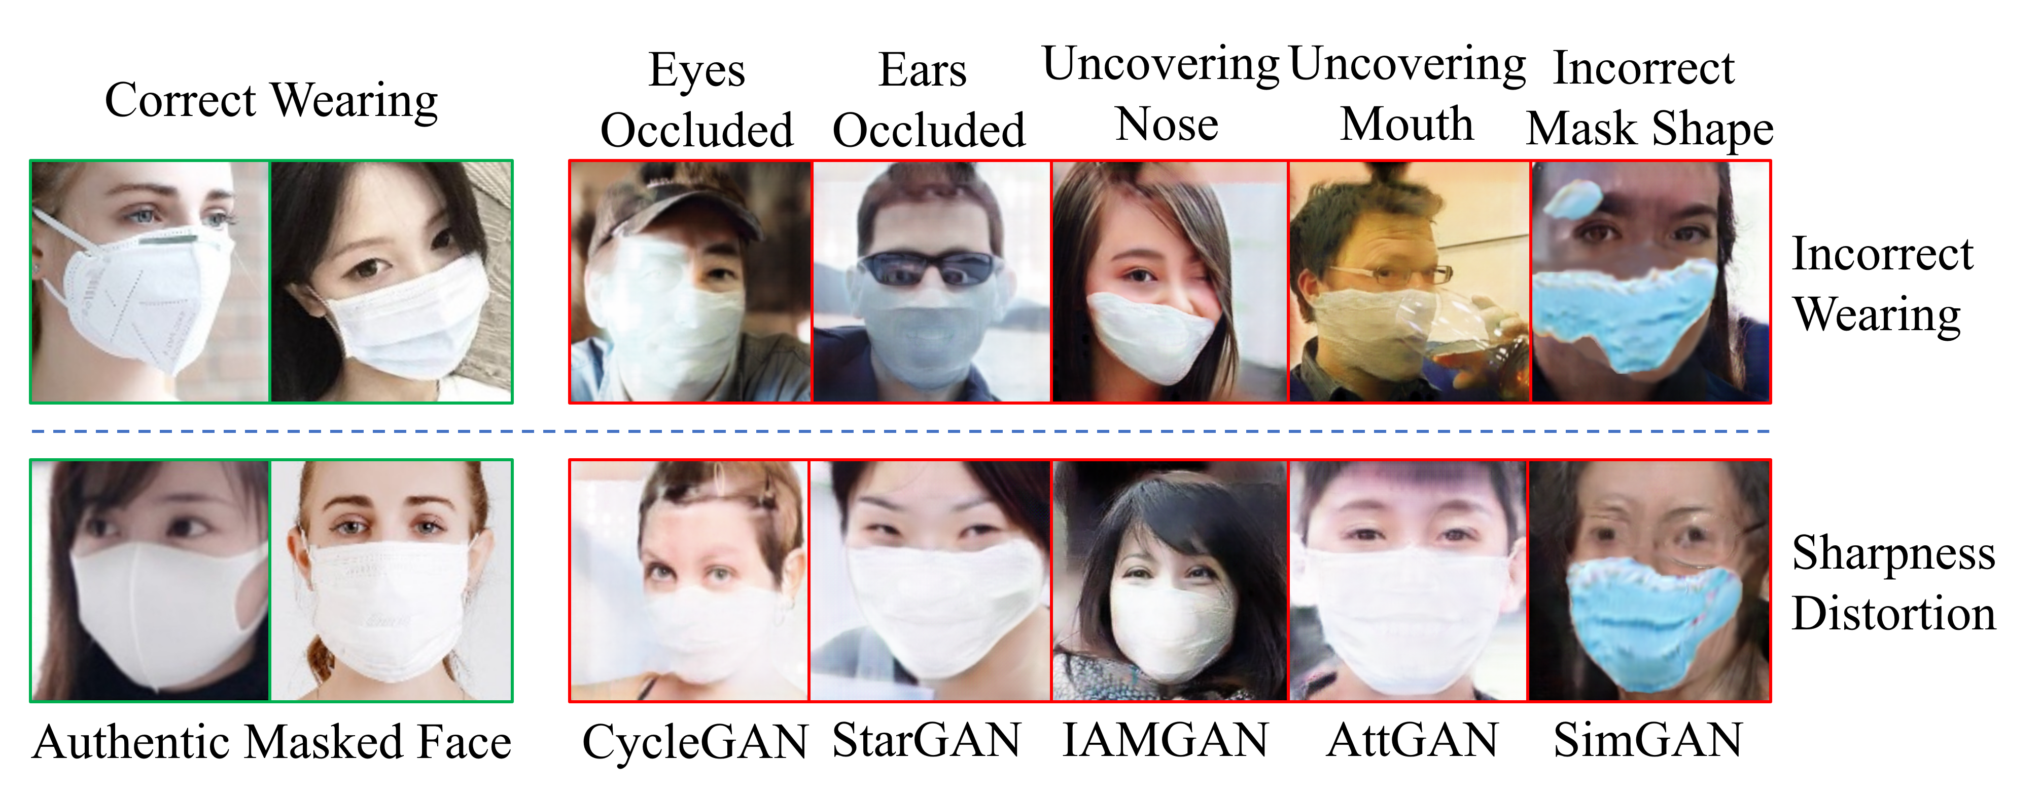
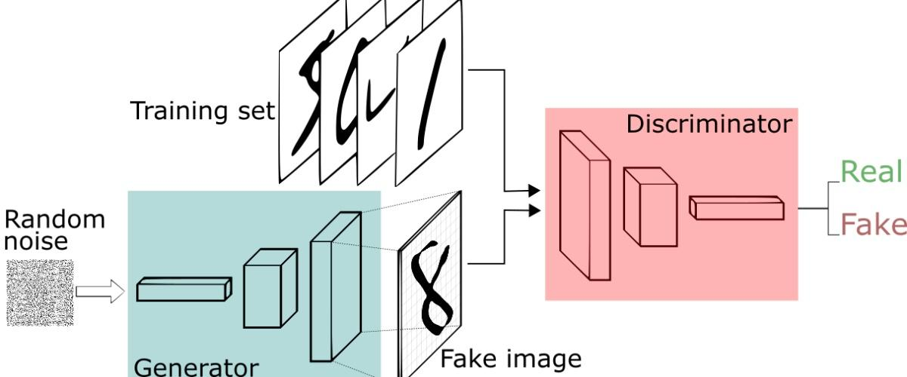
Introduction
MFR: A hurdle to break through
Problem
Lacking real-world large-scale masked face datasets with identity labels.
Masked Face Synthesis
It directly overlay mask on face, which is prone to produce unnatural masked face.
Masked Face Generation
It is based on GANs to generate more realistic masked faces to alleviate the problem.
Generative Adversarial Networks (GANs)
Introduction
Method
Experiments
Conclusions
3

Slide 7
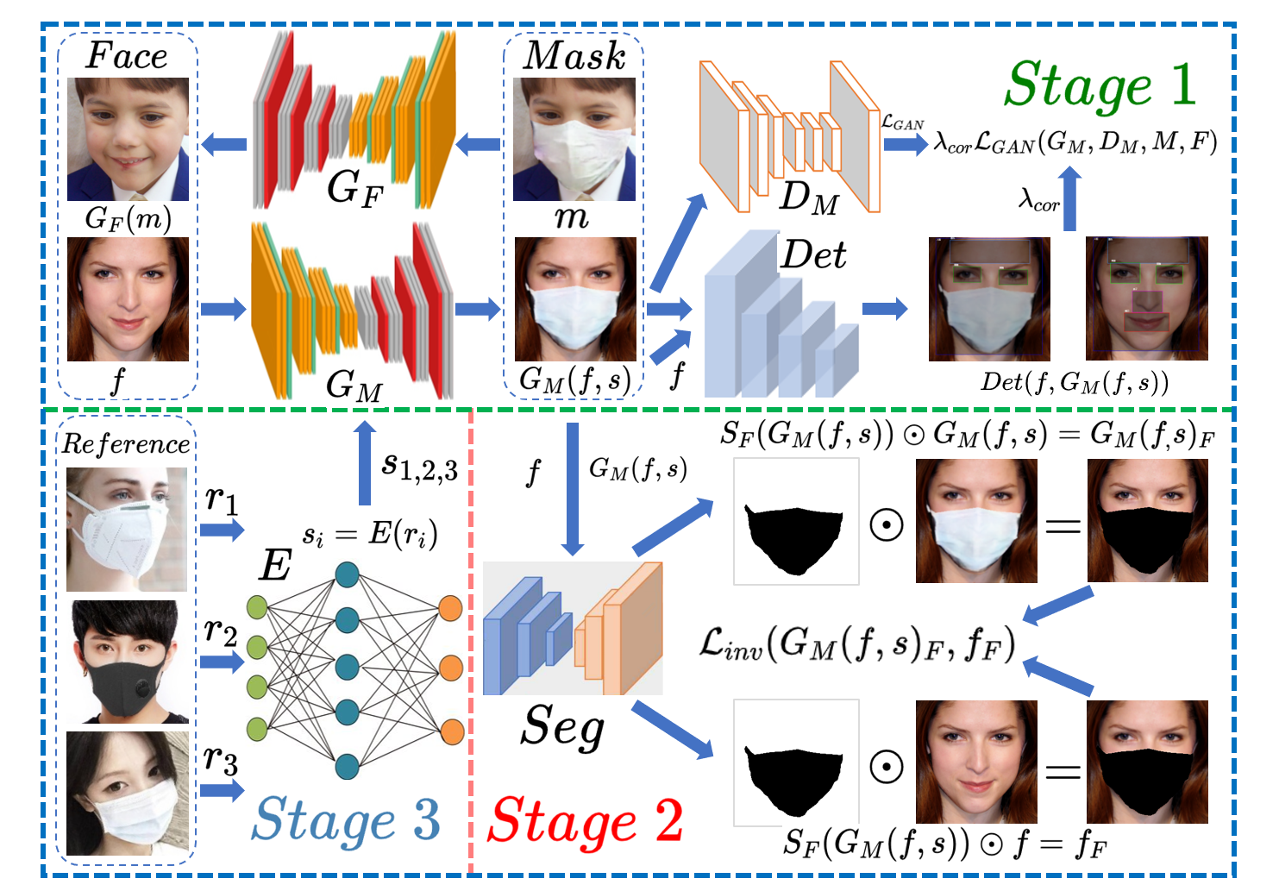

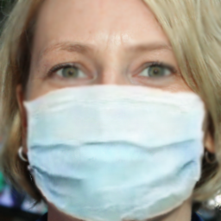

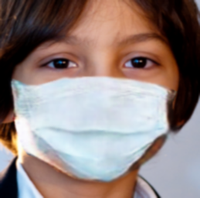
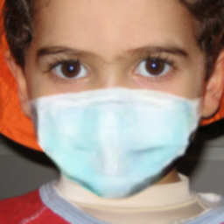
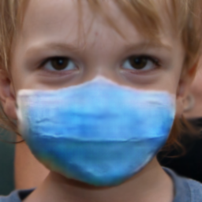
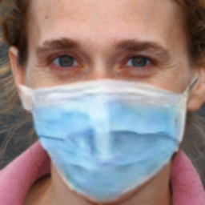
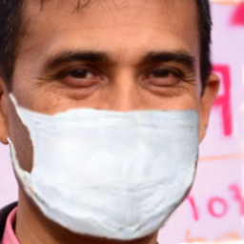
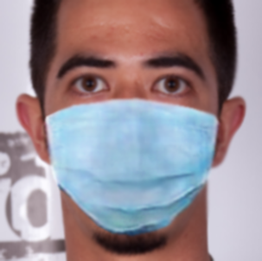
Method
A three-stage training pipeline to generate masked face images
Female
Children
Male
Introduction
Method
Experiments
Conclusions
4

Slide 8
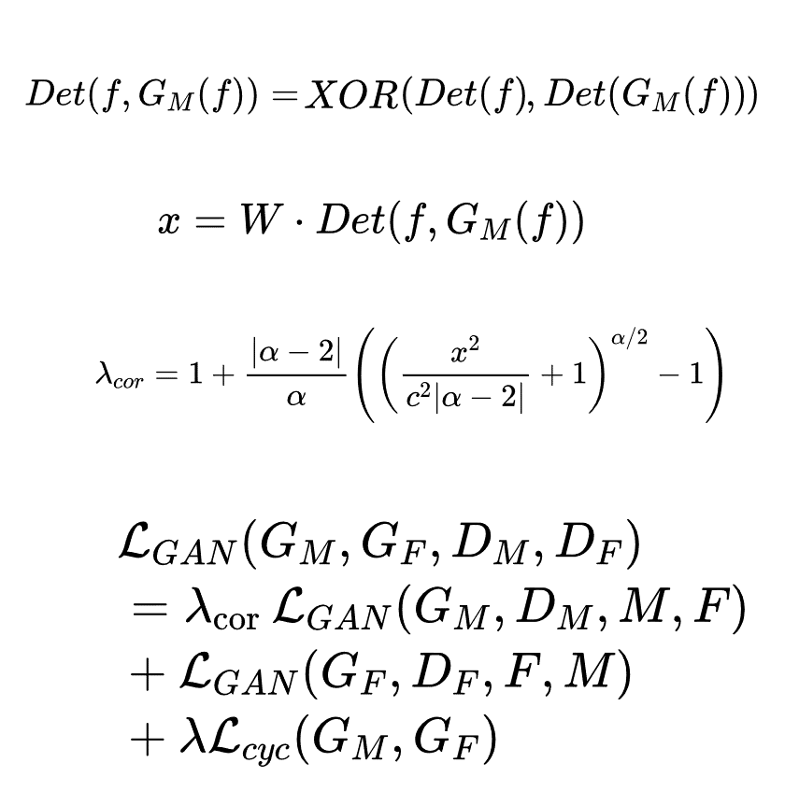
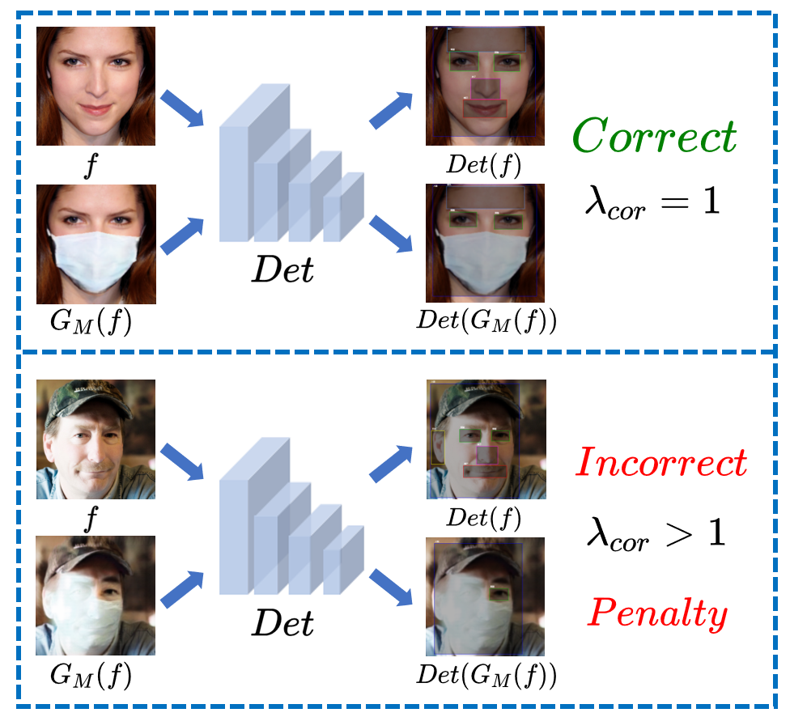
Method
Stage1: Generate correct mask occlusions
Facial Feature Detector
Based on pretrained Yolov3
Facial Detection Results
Penalty Value
Adaptive Correction Factor
The objective function of stage 1
Introduction
Method
Experiments
Conclusions
5

Slide 9
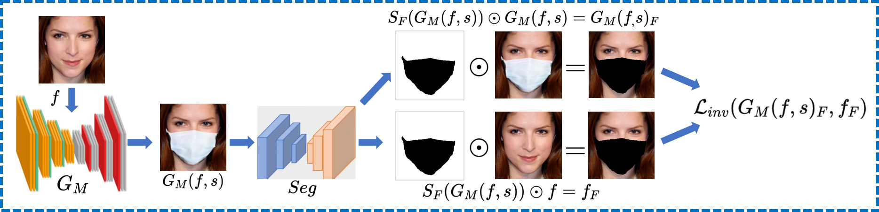
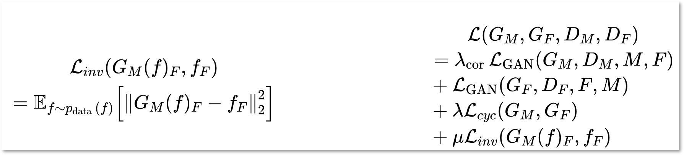
Method
Stage2: Generate authentic-looking images
Mask Binary Segmentation
Based on pretrained U-Net
Local Invariance Loss
The objective function of stage 2
Local Invariance Loss
Introduction
Method
Experiments
Conclusions
6

Slide 10
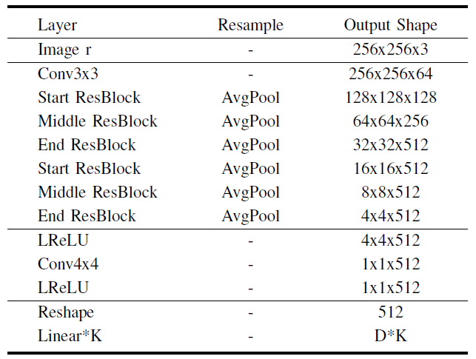
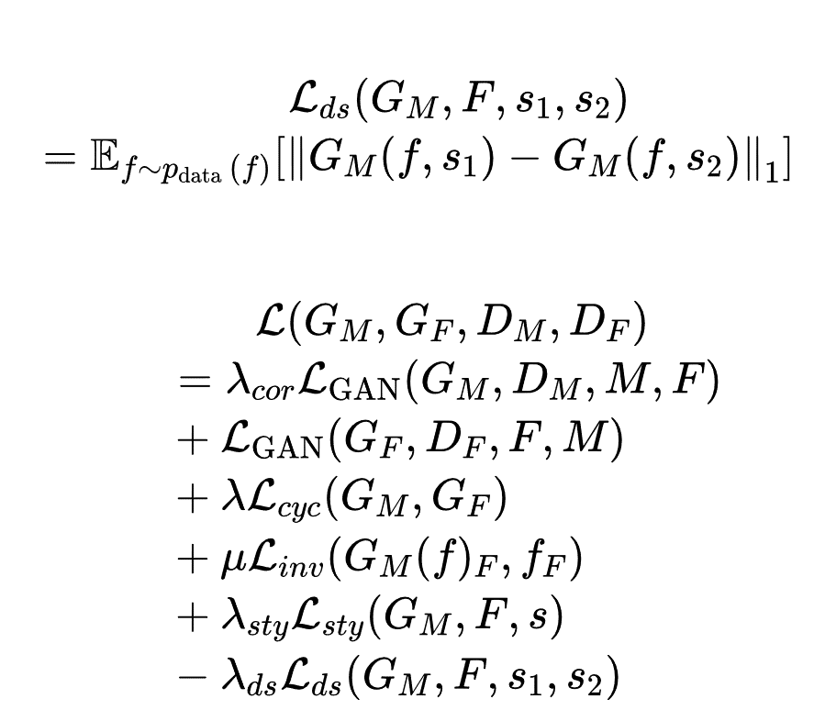
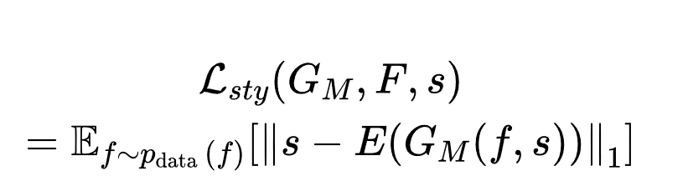
Method
Stage3: Generate type-diverse masked face images
Mask Style Encoder
Style Diversification Loss
The objective function of stage 3
Style Reconstruction Loss
Introduction
Method
Experiments
Conclusions
7

Slide 11
Experiments
Datasets and implementation details
 | MFGAN | Yolov3 | U-Net | MFR models
Datasets | FFHQ (face) RMFRD (masked face) | RMFRD | RMFRD | CelebA (face) M-CelebA (masked face)
Optimizer | Adam | Adam | SGD | SGD
Steps | Stage1: 100K Stage2: 200K Stage3: 150K | 62.5K | 20K | 30 epochs
Batch Size | 1 | 8 | 8 | 128
Learning Rate | 0.0002 | 0.001 | 0.001 | 0.05
Baseline | (1) Domain Translation: CycleGAN, SimGAN (2) Facial Attribute Editing: SaGAN, AttGAN (3) Masked Face Generation: StarGAN, IAMGAN (4) Masked Face Synthesis: MaskTheFace | — | — | Softmax Triplet CosFace ArcFace
Evaluation Metrics | SSIM, PSNR, FID | Validation mIoU | AP50 | Verification accuracy, TAR@FAR=1e-3, Rank-5
Introduction
Method
Experiments
Conclusions
8

Slide 12
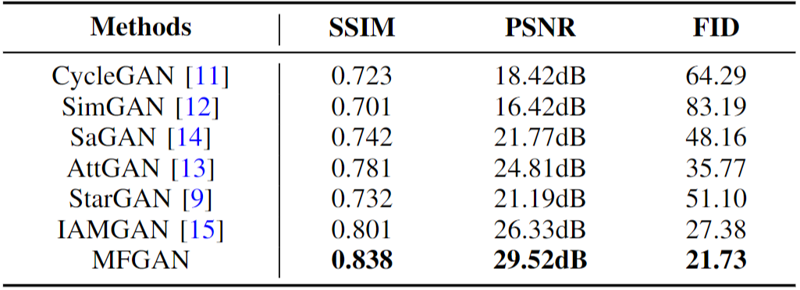
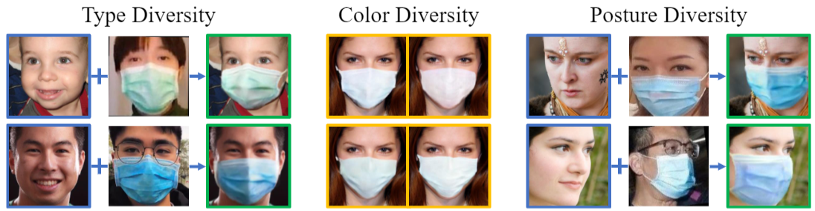
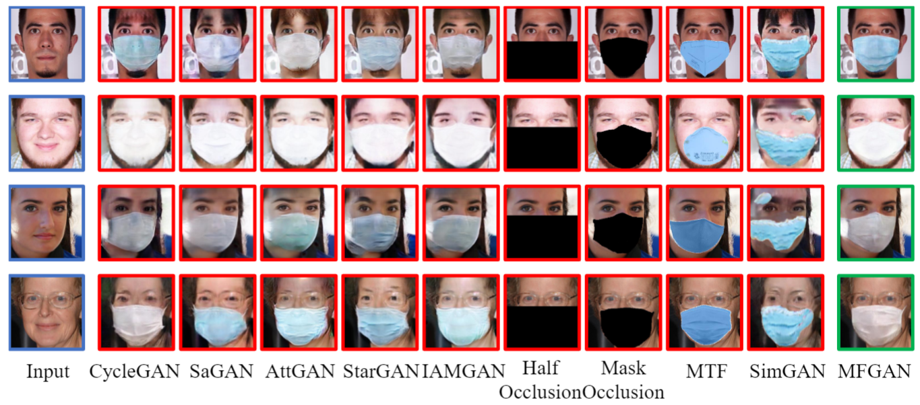
Experiments
Comparison of masked face image generation effect
Quantitative Comparison Results
Diversity Display
Qualitative Comparison Results
Introduction
Method
Experiments
Conclusions
9

Slide 13
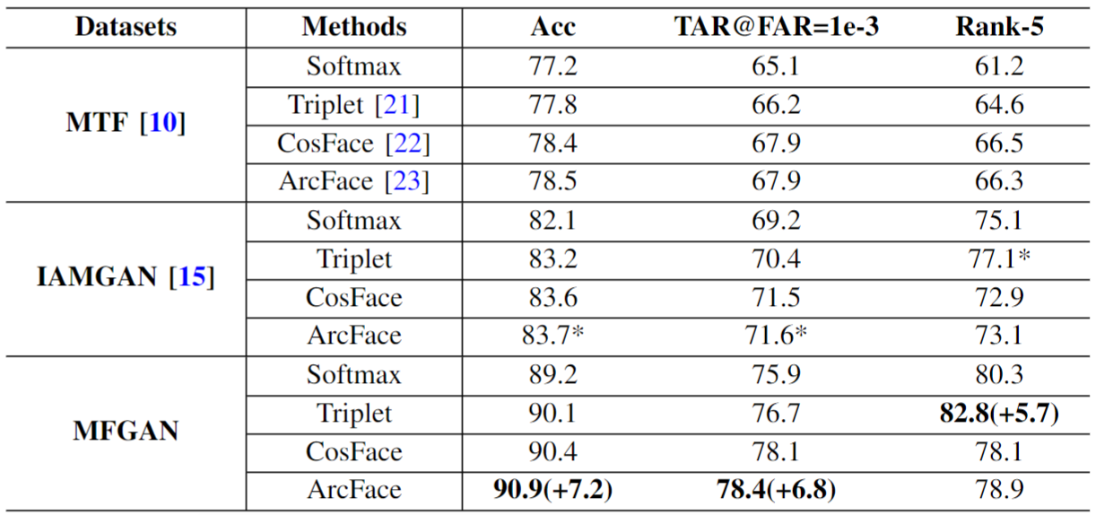
Experiments
Comparison of MFR training effect on generated datasets
The Comparison of Training Effects
Introduction
Method
Experiments
Conclusions
10

Slide 14
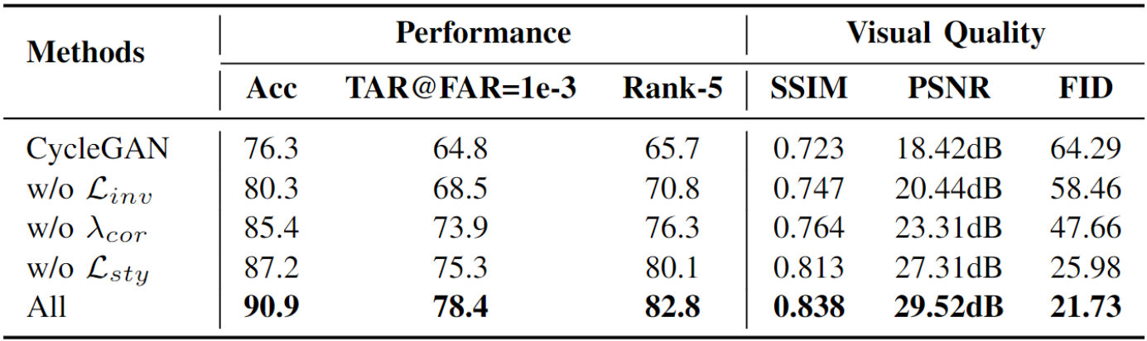
Experiments
Ablation study
Ablation Experiment Results
Introduction
Method
Experiments
Conclusions
11

Slide 15
Conclusions
Main work and contributions
Goal
Alleviate the difficulty of lacking large-scale real-world masked face datasets.
Solution
CycleGAN-based masked face generation method MaskedFaceGAN (MFGAN).
Effect
Generate correct, authentic-looking and type-diverse masked face while ensuring the invariance of facial features.
Optimization
Three-stage training pipeline, a facial feature detector, a mask binary segmentation module and a mask style encoder.
Experiments
The experiments of qualitative and quantitative comparison and MFR model training effect comparison.
Conclusions
The practical significance and performance advantages of MFGAN have been proved.
Introduction
Method
Conclusions
Conclusions
12

Slide 16
Conclusions
Discussions and future work
Limitations
Due to the lack of large area facial features, the MFR task is inherently difficult, and the performance of existing methods is still unsatisfactory.
The performance improvement of MFR models training on the datasets generated by MFGAN fully proves the feasibility of training MFR models on generated datasets.
Thought
Future
Further enhance the robustness of MFGAN, and conduct in-depth research on MFR model.
Introduction
Method
Conclusions
Conclusions
13

Slide 17
Acknowledgment
This work is supported by the following fund projects
The Fundamental Research Funds for the Central Universities (Nos. SWU021001 and SWU021002)
The National Nature Science Foundation of China (No. 62106205)
The Project of Science and Technology Research Program of Chongqing Education Commission of China (No. KJZD-K202100203 and KJQN202100207)
The Natural Science Foundation of Chongqing (Nos. cstc2021jcyj-msxmX0824 and cstc2021jcyj-msxmX0565)
Thank You!

