Slide 1
Problem-specific knowledge based artificial beecolony algorithm for the rectangle layout optimization problem in satellite design
Yichun Xu, Shuzhen Wan, Fangmin Dong
College of Computer and Information Technology, China Three Gorges University
SEKE22

Slide 2
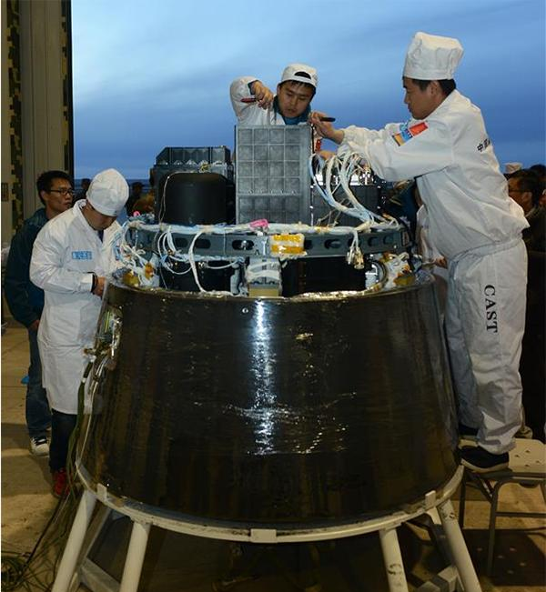
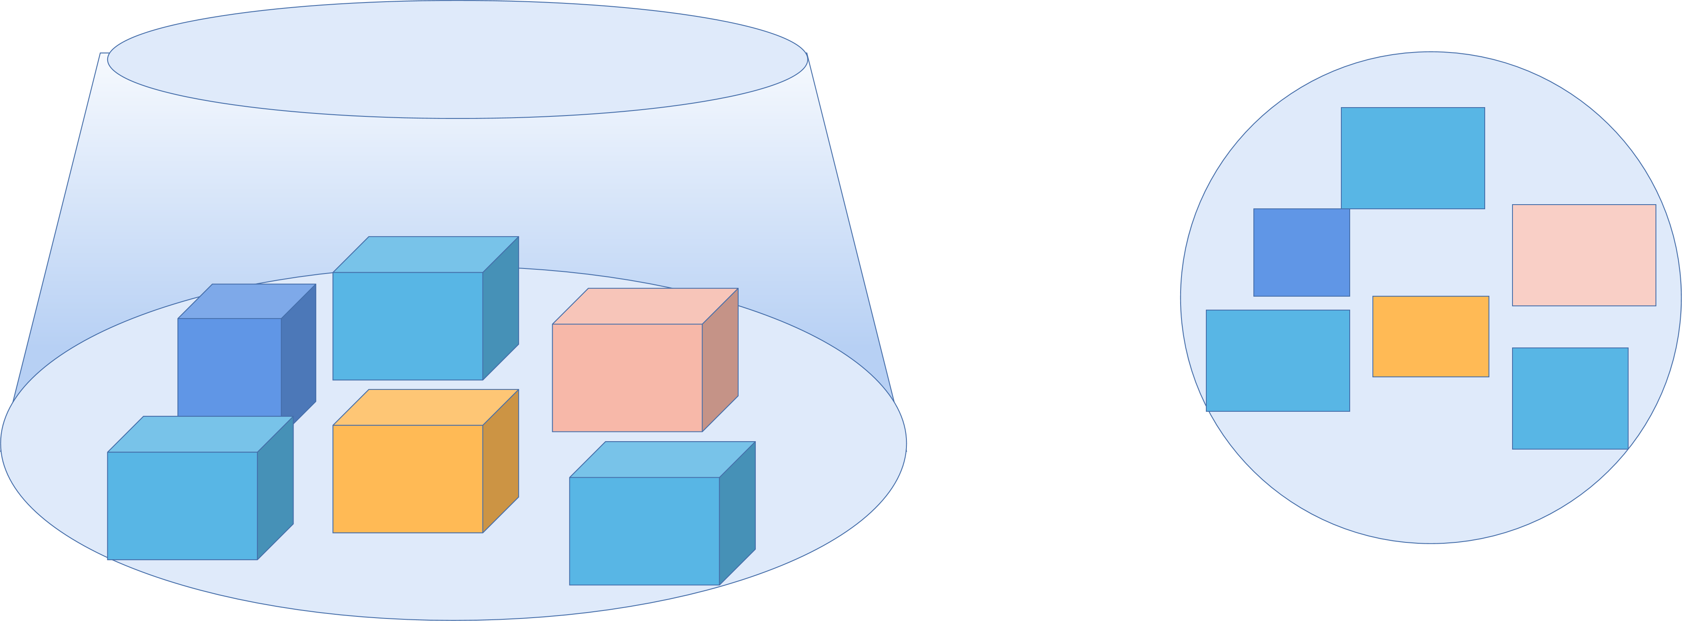
Introduction
This problem(RLOP) has a background of satellite design,that a set of objects is installed on a circular load board inside a cylindrical satellite cabinet. The two main constraints should be handled are (1) the space occupied by a given collection of objects (envelopment), and (2) the imbalance of the system.
http://inews.ifeng.com/48504076/news.shtml

Slide 3
Introduction
Meta-heuristics were proposed for this problem :
--Genetic algorithms (Xu10),
--Particle swarm optimization (Huang11),
--Simulated annealing algorithm (Xu08) ,
--Ant colony optimization (Ji10).
IBF(Liu17) used quasi-physics and quasi-human strategies, a kind of gradient descent method.
(Zhong 19) proposed a 3-dimensional model , but most optimization was in 2-d space.
precious study: The searches are nearly blind (no cues on where to find the optimum)
Our study: 1 based on a constructive heuristic
2 artificial bee colony algorithm, combined with the problem-specific knowledge
3 the best known results.

Slide 4
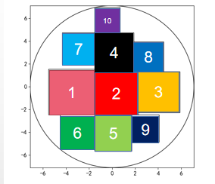

Model
Given Rects (l₁, w₁, m₁), (l₂, w₂, m₂), . . . , (l_{n}, w_{n}, m_{n}), where l_{i}, w_{i} , and m_{i} are the length, the width, and the mass of rectangle i.
The list X = (x₁, y₁, θ₁),(x₂, y₂, θ₂), . . . , (x_{n}, y_{n}, θ_{n}) denotes a layout, where x_{i}, y_{i} is the center of the rectangle i, and θ_{i} denotes its orientation.
Constraint 1: θ_{i} ∈ {0, 1}, where θ_{i}=0 or 1 mean the items have only two orientation ( orthogonal placed)
Constraint 2: There is no overlap between any two rectangles
Constraint 3: The center of mass of the system should be located at the center of the circle
Objective: minimizing

Slide 5
Our approach
based on an existing constructive kernel heuristic (CKH)
artificial bee colony algorithm, combined with the problem-specific knowledge

Slide 6
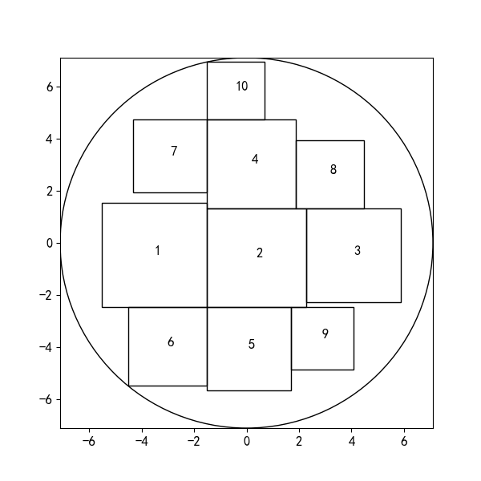
CKH
1
2
3
4
5
6
7
8
9
10
Pack items one by one according to a given
order.

Slide 7
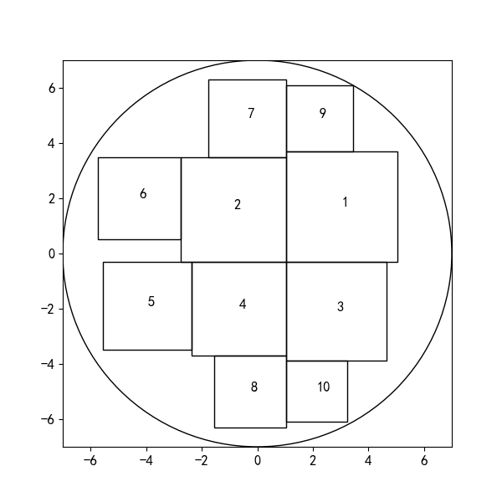
Different order resulting different layout by CKH
10
7
9
7
4
8
6
2
1
1
2
3
5
4
3
6
5
9
8
10
.
Because different orders result in different layouts, meta heuristics are applied to search the best permutation.

Slide 8
Problem specific information
10
7
4
8
1
2
3
6
5
9
.
We find that the bigger and heavier objects should be placed first, which means a greedy permutation g in the descending order of l_{i}w_{i}m_{i} can lead to a good layout.
This finding relates the concept of inversion count to the goodness of a permutation.

Slide 9
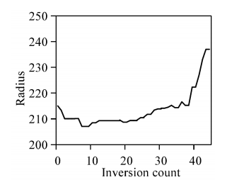
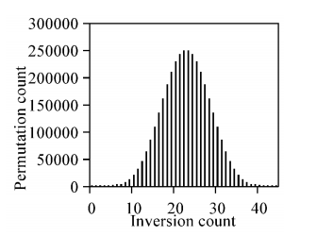
Problem specific information
.
We use a set with 10 rectangles to investigate the distribution of the layouts.
Left: permutations with inversion count less than 10 lead to the best permutation
right: The number of permution whose inversion count less then 10 is very small.
This prompts that we should focus on the permutations with less inversion count. The search space is quite small.

Slide 10

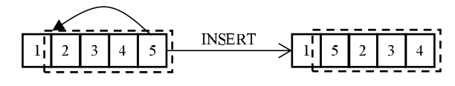

artificial bee colony algorithm(ABC)
Like the genetic algorithm, ABC is a natural inspired optimizer based on a population of “artificial bees”
1 Fitness function :
2 Population initialization :
s₁ is the greedy permutation (p₁, p₂, p_{3,}..., p_{n}), the other n − 1 individuals are generated by swapping two adjacent elements of p₁,
s₂=(p₂, p₁, p_{3,}..., p_{n}),
s₃=(p₁, p₃, p_{2,} ..., p_{n}), ...,
s_{n}=(p₁, p₂, p_{3,}..., p_{n,}p_{n-1}) The search starts with the inversion count less than 2.
3 Mutation operator: the individuals should be mutated by the INSERT operator ( Serpell10) during the search
.
4 Selection probability: Each individual has the chance of P(s_{i}) to be improved

Slide 11
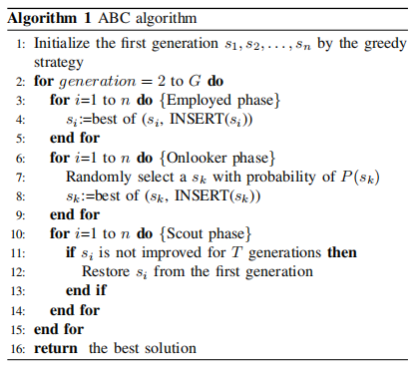
artificial bee colony algorithm(ABC)
.

Slide 12
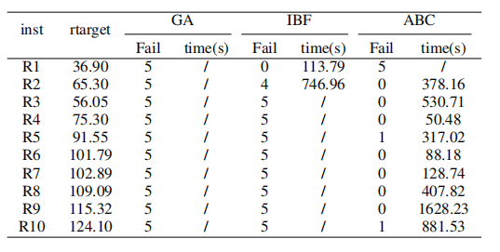
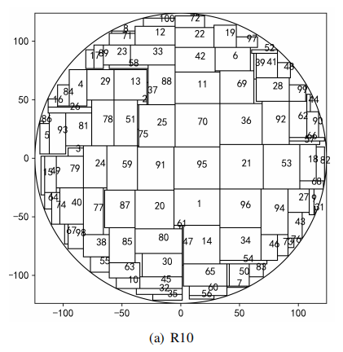
Results
Data set: In (Liu17), 10 instances,
10-100 rectangles per instance
baselines: GA ( Xu10), IBF(Liu17)
--the stopping criterion: obtaining a layout with
envelopment radius less than the rtarget, or execution time exceeding an hour.
--5 runs on each instance

Slide 13
Conclusion
1 A problem-specific knowledge based artificial bee colony (ABC) algorithm for the layout optimization problem is presented.
2 On an open benchmark with 10 instances, ABC outperforms the genetic algorithm on all the instances, and outperforms the quasi-human algorithm on nine of them.
Thank you for listening!

