Slide 1
On the Implications of Human-Paper Interaction for Software Requirements Engineering Education
Pankaj Kamthan
Department of Computer Science and Software Engineering
Concordia University, Montreal, Canada
The Thirty Fourth International Conference on Software Engineering and Knowledge Engineering (SEKE 2022)
Pittsburgh, U.S.A.
July 1-10, 2022

Slide 2
Dedication
In Remembrance of
Leslie Cohen, Terrill Fancott, Peter Grogono, Urmila Kamthan
Gone in 2020 and 2021, but Not Forgotten

Slide 3
Acknowledgement
Eleni Panagiotarakou
Cast of Many Committed Students

Slide 4
Agenda
A Few Points about Software Requirements Engineering
A Very Brief Tour of the History of ‘Old’ Things
A Mild Warning on being Enamored with ‘New’ Things
Software Requirements Engineering Education on Paper
Concluding Remarks

Slide 5
Necessity of Human-Centeredness of
Software Development Methodologies
  Software is becoming indispensable.
    The circumstances of COVID-19 pandemic have only exacerbated societal dependence on software.
  Lot of software is aimed towards humans:
    Booking, Banking, Driving, Educating, Gaming, Conferencing, Shopping, and so on.
  In the 1970s, Manny Lehman classified software into S-Type, P-Type, and E-Type.
    An E-Type software reflects human processes and its behavior is strongly connected to the environment in which it operates.

Slide 6
Nature of Software Requirements Engineering:
Software Engineering Version
  Requirements engineering (RE) is one of the earliest phases of software development, and exercises a lot of control on what comes in later phases.
  Any errors during RE can propagate to later phases and can be very difficult and very expensive to rectify.

Slide 7
Nature of Software Requirements Engineering:
English Version
  If I am going to develop something for you, I should know something about you, the user (your background, needs, preferences, mental and physical abilities, and so on).
  If I do not understand the problem, how can I come up with a solution?
  RE of software often deals with Wicked Problems.
    The act of finding a solution to the problem improves the understanding of the problem itself.

Slide 8
Nature of Software Requirements Engineering:
Human Version
  RE of software aimed towards humans needs to be human-centered.
  RE needs tools.
  RE tools should be human-centered.
  Paper is one such tool.

Slide 9


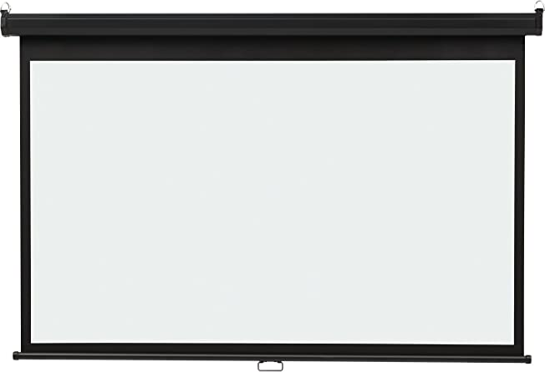

Once Upon a Time in a Classroom
Blackboard
Whiteboard
Transparency-Projector
Time

Slide 10


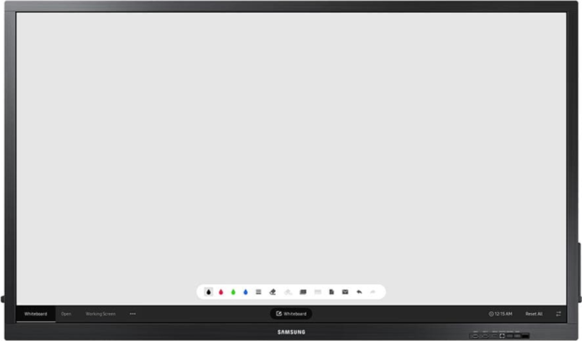
Once Upon a Time in a Classroom
Slide-Projector
Smartboard
Time

Slide 11
Sometimes, Old Ways Are Better
  Blackboard is still with us; old but not obsolete!
  New is not automatically better than old; new is not universally better than old.
  New is not a reason for adoption; old is not a reason for abandonment.
  This applies to paper.

Slide 12
Need to Avoid
Temptation and Delusion of Innovation
  The history of software engineering follows a path of thesis, antithesis, and synthesis.
  — Barry Boehm in 2006
  In the name of novelty, software engineering should not become a temporally-unidirectional fashion industry.
  Decisions regarding selecting RE tools should be based on need and merit (and cost).

Slide 13
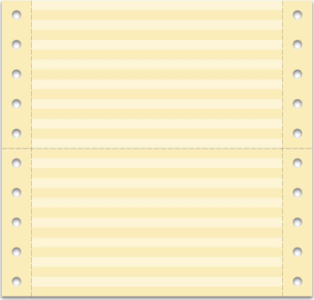
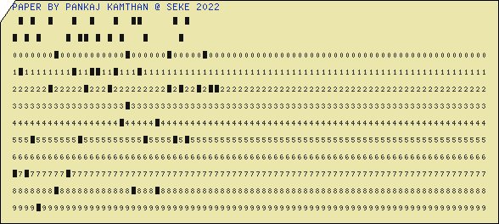
Once Upon a Time for a Computer I/O

Slide 14
What Can Be Done Using Paper?

Slide 15
What Makes Paper Unique?
The Human Connection
  Breathability
  Emotivity
  Identity
  Resiliency
  Tangibility
  Temporality
  Versatility
Humans have Affinity
to
Human-Like Things!
Paper Gets
Dirty and Old!
Organic
and
Anthropomorphic!

Slide 16
The Hand is Mightier than the Mouse
  Handwriting, typing, and clicking are different activities.
  Freehand drawing and using a graphics editor are different activities.
  On paper, there are no aids, but there are also no constraints of the types of characters or symbols (available on the keyboard) or icons or shapes (available on the menu).

Slide 17
25 Years of Mathematical Typesetting and Diagramming, and Counting!
  Handwriting mathematical expressions is cheaper on paper than typesetting them on digital media.
  Drawing initial versions of complex (software engineering) diagrams is cheaper on paper than on digital media.

Slide 18
To Err is Human, To Forgive Paper
  Paper does not interfere in your work or nag when you cannot.
  Paper does not make you feel inadequate for your lack of computer skills.
  You can easily correct and excuse yourself for your mistakes on paper!
  You can jot down a spur-of-the-moment idea on a paper napkin at a restaurant.
  You are allowed to spill coffee on paper.

Slide 19
Software Requirements Engineering Education:
Types of Paper — Activities/Artifacts
User Stories
Mind Mapping

Slide 20
Software Requirements Engineering Education:
Using Paper for Thinking and Doing in Tranquility
  No Clicking
  No Loading-and-Waiting
  No Panning
  No Zooming
  No Advertisements
  No Clearing Cache
  No Connectivity
  No Electrical Power Loss
  No Emission of Heat or Light
  No Error Messages
  No Glare
  No Multitasking
  No Noise
  No Pop-Up Windows
  No Spellcheckers
  No Updates
  No Viruses
Paper
Digital Media

Slide 21
A Student Survey-In-Progress:
Responses
  Student 1:
    “I have learned different uses of colored paper.”
  Student 2:
    “I have become better at reading others’ handwritings.”
  Student 3:
    “I was occupied enough with paper to not miss my smartphone!”

Slide 22
Conclusion
  Learning RE is not only about the product, but also about the people and the process.
  Students should be discouraged to seek Maslow's Hammer and be encouraged to become polyliterate.
  Paper and digital media are not competing, but complementing.
  Educators should aim for harmonic co-existence of paper and digital media.

