Slide 1


SEKE2022 - PAPER 005
Graph Embedding Models for Community Detection
Yinan Chen, Zhuanming Gao, Dong Li
South China University of Technology, Guangzhou 510006, China
2022.7

Slide 2
Introduction

Slide 3
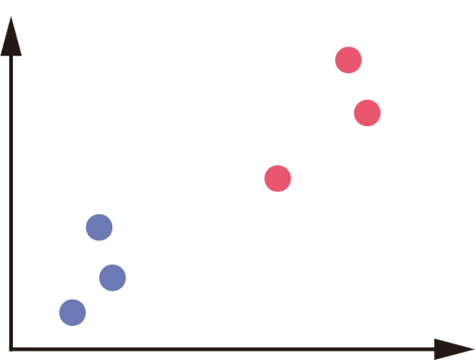
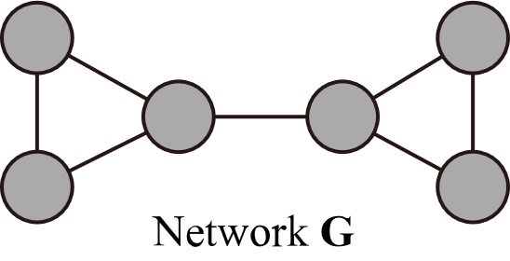
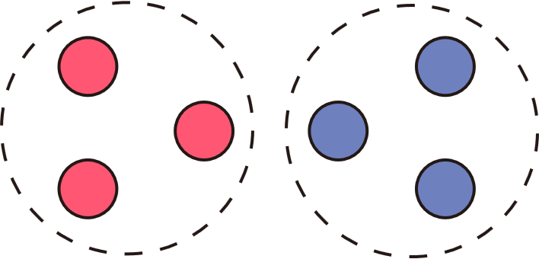
Objective
Input: a network
Output: embeddings of the network
Direction: community detection
Our models
Embeddings
for community detection

Slide 4
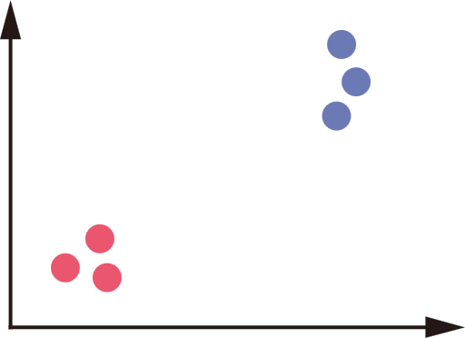
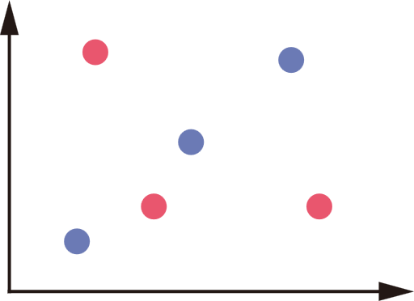
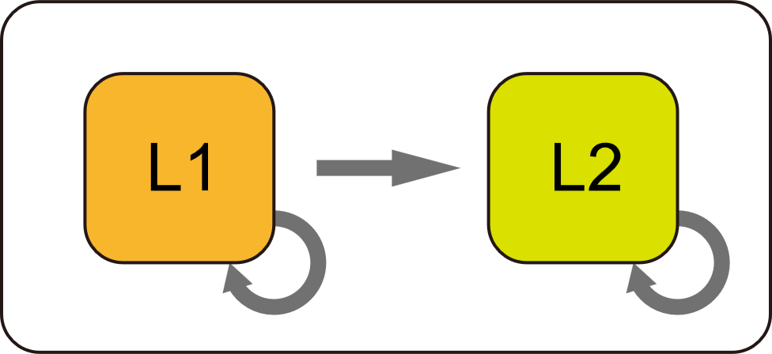
Main Procedure
Result embeddings
Initialize embeddings randomly
Update embeddings using
loss functions L1 and L2

Slide 5
The methods

Slide 6
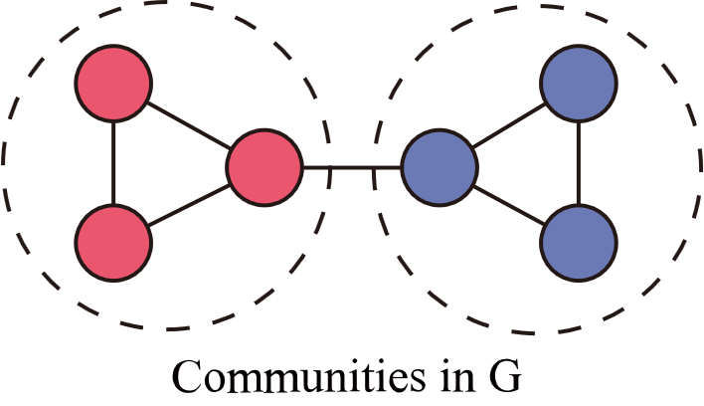
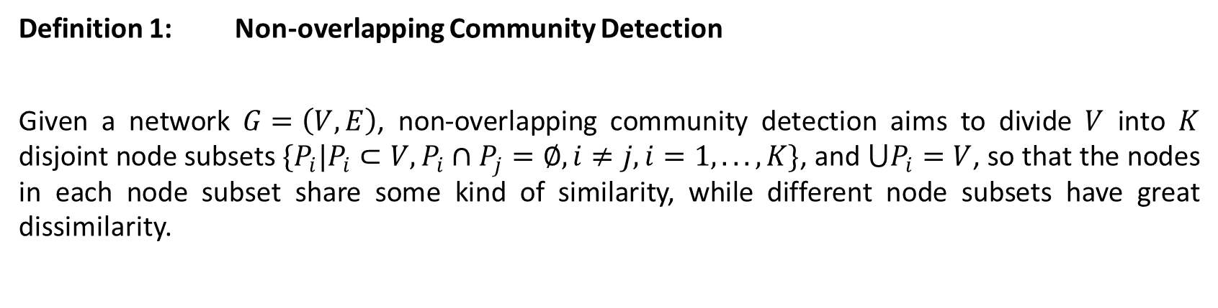
Definitions - 1
Definition 1: Non-overlapping Community Detection
Given a network $G=\left(V,E\right)$, non-overlapping community detection aims to divide $V$ into $K$ disjoint node subsets $\{P_{i}|P_{i}⊂V,{P_{i}∩P}_{j}=∅, i≠j,i=1,...,K\}$, and $⋃P_{i}=V$, so that the nodes in each node subset share some kind of similarity, while different node subsets have great dissimilarity.

Slide 7
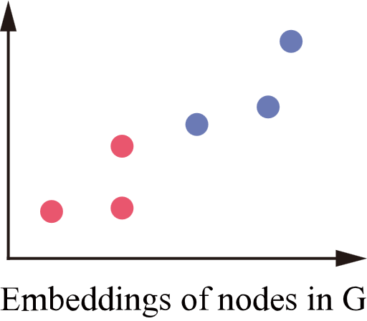
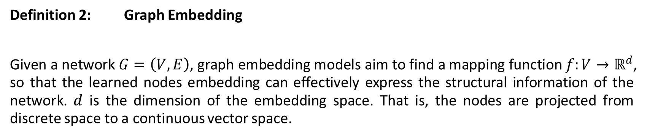
Definitions - 2
Definition 2: Graph Embedding
Given a network $G=\left(V,E\right)$, graph embedding models aim to find a mapping function $f:V→ℝ^{d}$, so that the learned nodes embedding can effectively express the structural information of the network. $d$ is the dimension of the embedding space. That is, the nodes are projected from discrete space to a continuous vector space.

Slide 8
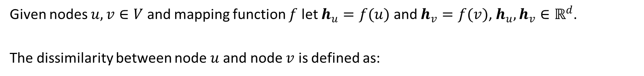


Node Similarity
Given nodes $u,v∈V$ and mapping function $f$ let $h_{u}=f(u)$ and $h_{v}=f(v)$, $h_{u},h_{v}∈ℝ^{d}$.
The dissimilarity between node$u$ and node $v$ is defined as:
$$dissim\left(u,v\right)={\left\|h_{u}−h_{v}\right\|}_{2}$$
The opposite number of the dissimilarity is defined as the similarity measure between nodes:
$$sim\left(u,v\right)=−dissim\left(u,v\right)$$

Slide 9

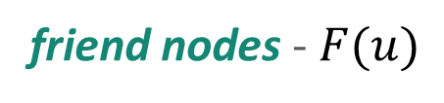
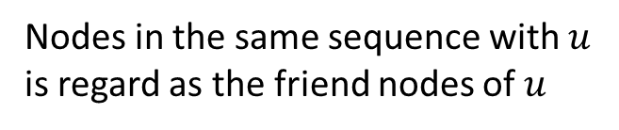


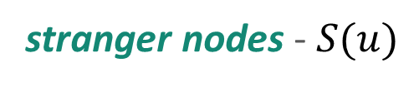

Friend nodes and stranger nodes
friend nodes - $F(u)$
Nodes in the same sequence with $u$ is regard as the friend nodes of $u$
Random walk $L$ steps in the network
$R∙N$ sequences
stranger nodes - $S(u)$
Randomly choose $L$ nodes in the network
stranger nodes of $u$

Slide 10
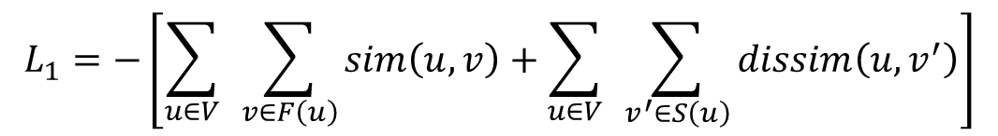

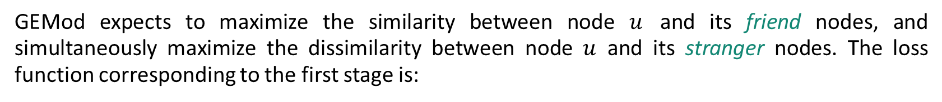
GEMod Algorithm - 1
GEMod expects to maximize the similarity between node $u$ and its friend nodes, and simultaneously maximize the dissimilarity between node $u$ and its stranger nodes. The loss function corresponding to the first stage is:
$$L_{1}=−\left[\sum_{u∈V}{ }\sum_{v∈F\left(u\right)}{sim\left(u,v\right)}+\sum_{u∈V}{ }\sum_{v^{′}∈S\left(u\right)}{dissim\left(u,v^{′}\right)}\right]$$
The embeddings are updated several iterations using $L_{1}$, then entered the second stage, where the embeddings are updated using $L_{2}^{mod}$.
$$L_{2}^{mod}=L_{1}−αM$$
where $α$ is a hyper-parameter used to balance the influence of $M$ on the result.
(c.o.)

Slide 11
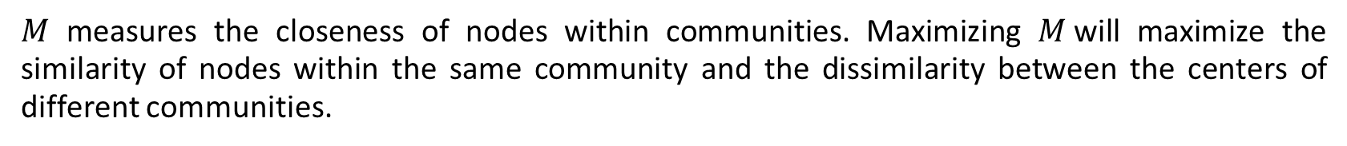
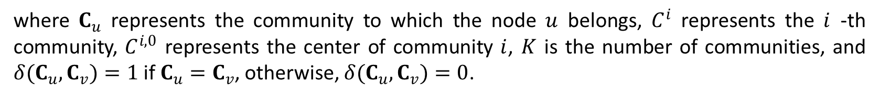
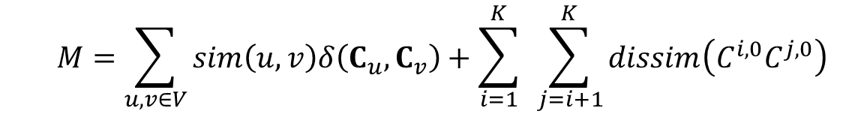
GEMod Algorithm - 2
$M$ measures the closeness of nodes within communities. Maximizing $M$will maximize the similarity of nodes within the same community and the dissimilarity between the centers of different communities.
$$\begin{aligned}M=\sum_{u,v∈V}{sim\left(u,v\right)δ\left(C_{u},C_{v}\right)}+\sum_{i=1}^{K}{ }\sum_{j=i+1}^{K}{dissim\left(C^{i,0}C^{j,0}\right)}\#\end{aligned}$$
where $C_{u}$ represents the community to which the node $u$ belongs, $C^{i}$ represents the $i$ -th community, $C^{i,0}$ represents the center of community $i$, $K$ is the number of communities, and $δ(C_{u},C_{v})=1$ if $C_{u}=C_{v}$, otherwise, $δ(C_{u},C_{v})=0$.
Thus, stage 2 makes more compact and separated clusters.

Slide 12
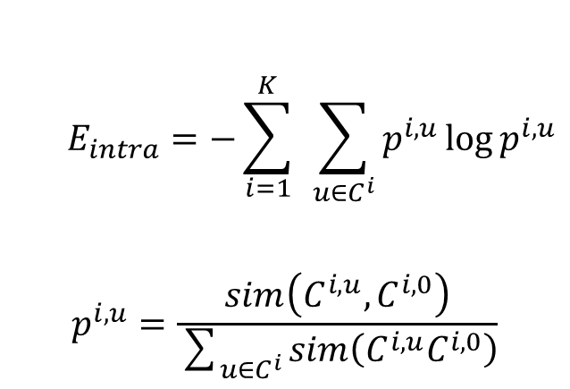

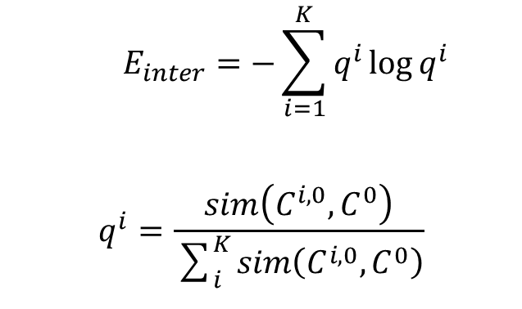
GEMap Algorithm
The first stage (L1 as loss function) of GEMap is the same as GEMod, the second stage tries to minimize the intra-community entropy and maximize the inter-community entropy, which are defined as:
$$\begin{aligned}E_{intra}=−\sum_{i=1}^{K}{ }\sum_{u∈C^{i}}{p^{i,u}\log{p^{i,u}}}\end{aligned}$$
$$\begin{aligned}p^{i,u}=\frac{sim\left(C^{i,u},C^{i,0}\right)}{\sum_{u∈C^{i}}{sim\left(C^{i,u}C^{i,0}\right)}}\end{aligned}$$
$$\begin{aligned}E_{inter}=−\sum_{i=1}^{K}{q^{i}\log{q^{i}}}\end{aligned}$$
$$\begin{aligned}q^{i}=\frac{sim\left(C^{i,0},C^{0}\right)}{\sum_{i}^{K}{sim\left(C^{i,0},C^{0}\right)}}\end{aligned}$$
The loss function of the second stage of GEMap algorithm is:
$$L_{2}^{map}=L_{1}+β(E_{intra}−E_{inter})$$

Slide 13
Experiments

Slide 14
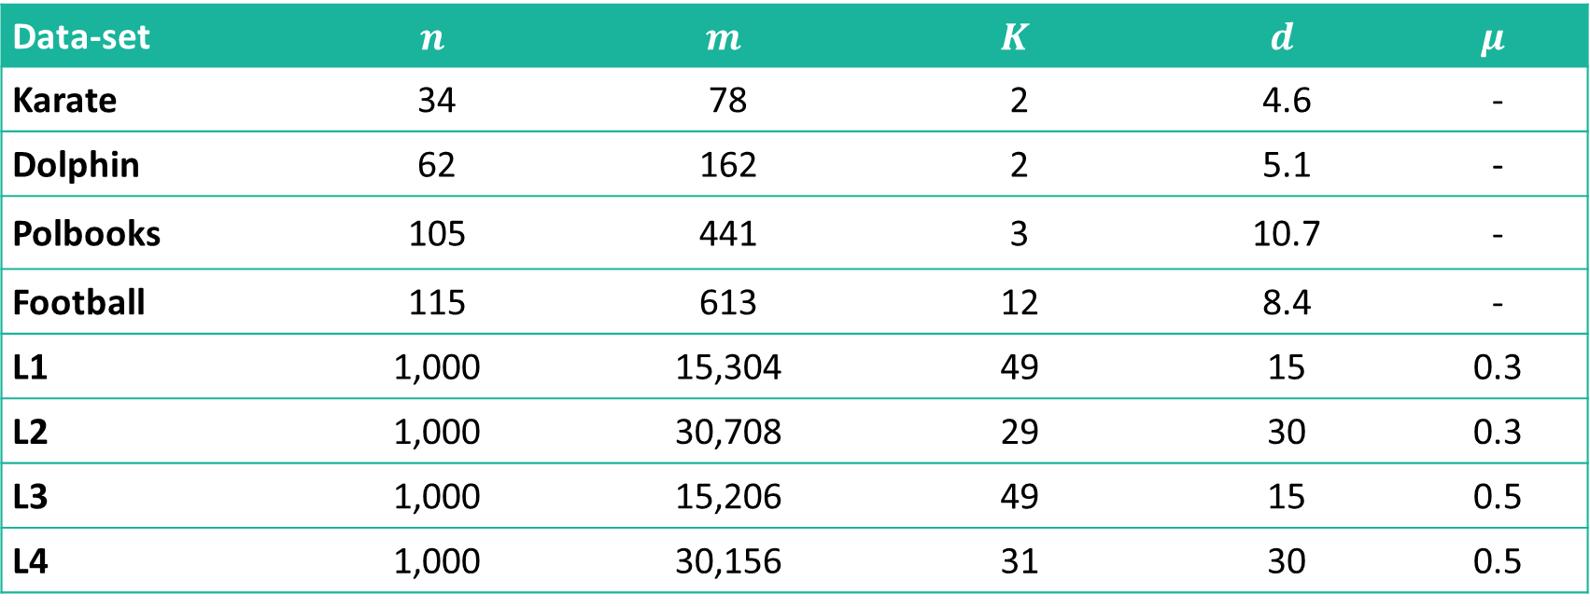
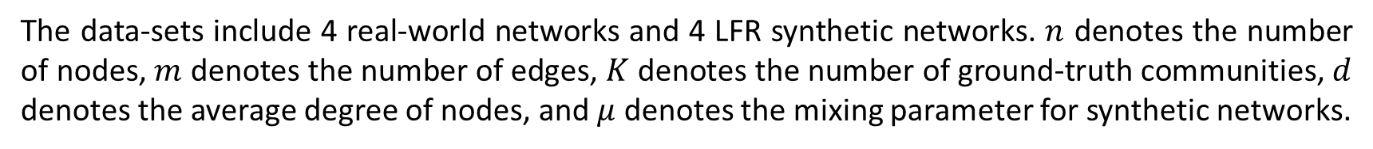
Data-sets
Data-set | $$n$$ | $$m$$ | $$K$$ | $$d$$ | $$μ$$
Karate | 34 | 78 | 2 | 4.6 | -
Dolphin | 62 | 162 | 2 | 5.1 | -
Polbooks | 105 | 441 | 3 | 10.7 | -
Football | 115 | 613 | 12 | 8.4 | -
L1 | 1,000 | 15,304 | 49 | 15 | 0.3
L2 | 1,000 | 30,708 | 29 | 30 | 0.3
L3 | 1,000 | 15,206 | 49 | 15 | 0.5
L4 | 1,000 | 30,156 | 31 | 30 | 0.5
The data-sets include 4 real-world networks and 4 LFR synthetic networks. $n$ denotes the number of nodes, $m$ denotes the number of edges, $K$ denotes the number of ground-truth communities, $d$ denotes the average degree of nodes, and $μ$ denotes the mixing parameter for synthetic networks.

Slide 15

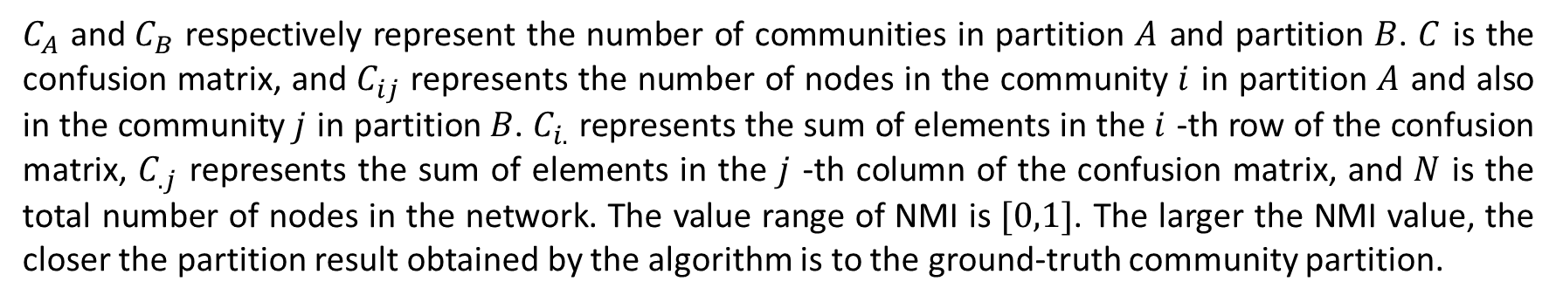
Evaluation Metric
The embeddings output by the methods are clustered using k-means, to obtain the community partitions for the input network. Then normalized mutual information (NMI) is used to measure the similarity between the partition output by algorithm and the ground-truth partition, which is defined as follows:
$$NMI(A,B)=\frac{−2\sum_{i=1}^{C_{A}}{ }\sum_{j=1}^{C_{B}}{ }C_{ij}\log_{2}\left(C_{ij}N/{C_{i∙}}C_{∙j}\right)}{\sum_{i=1}^{C_{A}}{ }C_{i∙}\log_{2}\left({C_{i∙}}/N\right)+\sum_{j=1}^{C_{B}}{ }C_{∙j}\log_{2}\left({C_{∙j}}/N\right)}$$
$C_{A}$ and${ C}_{B}$ respectively represent the number of communities in partition $A$ and partition $B$. $C$ is the confusion matrix, and $C_{ij}$ represents the number of nodes in the community $i$ in partition $A$ and also in the community $j$ in partition $B$. $C_{i.}$ represents the sum of elements in the $i$ -th row of the confusion matrix, $C_{.j}$ represents the sum of elements in the $j$ -th column of the confusion matrix, and $N$ is the total number of nodes in the network. The value range of NMI is $[0,1]$. The larger the NMI value, the closer the partition result obtained by the algorithm is to the ground-truth community partition.

Slide 16
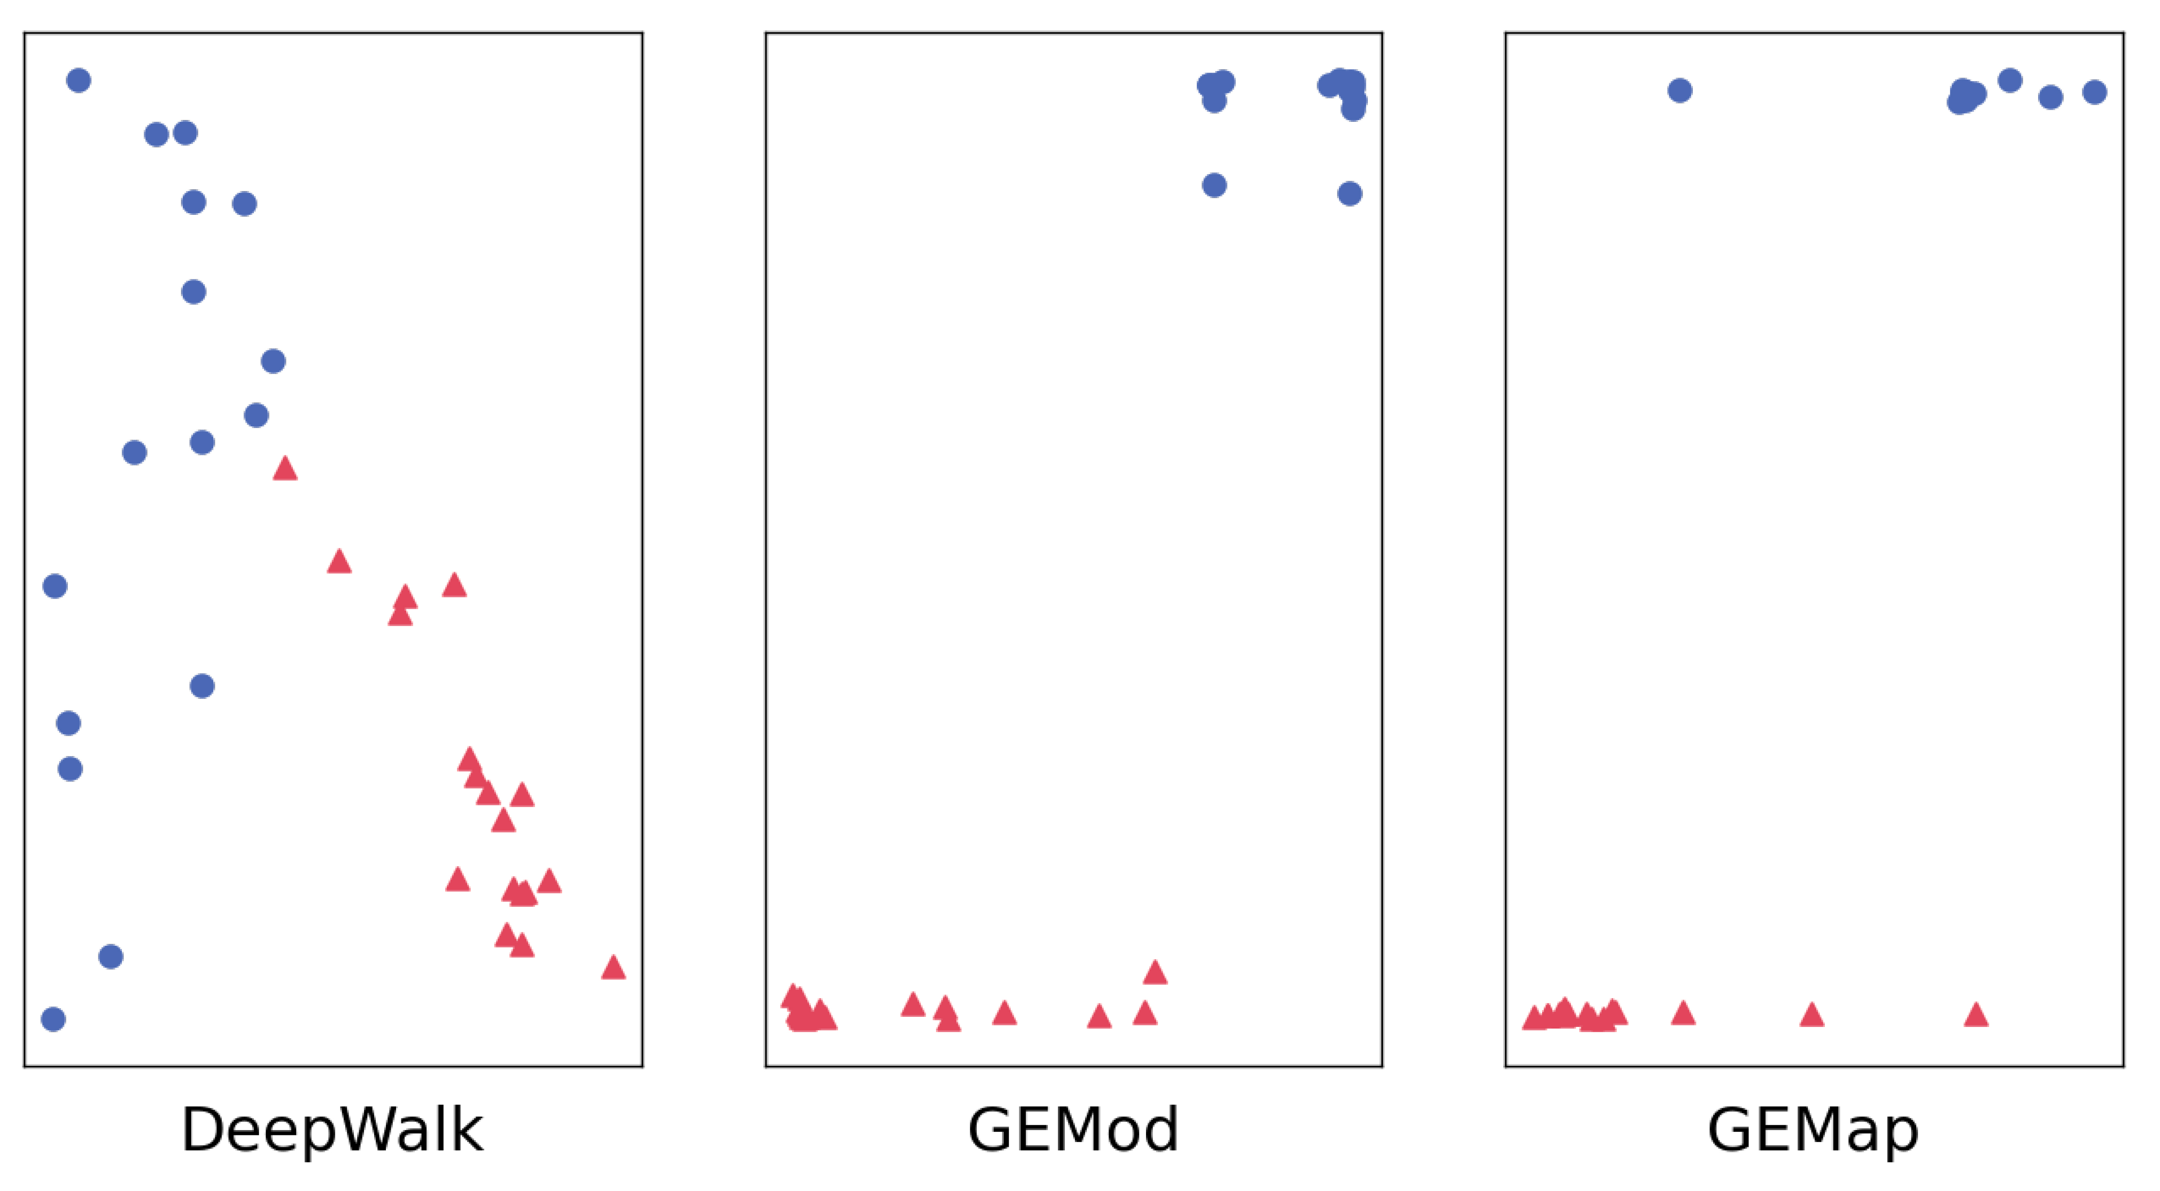
Embedding of Karate – Compared with Deepwalk
Deepwalk
GEMod
GEMap

Slide 17
Results – Real-world Networks
NMI | Karate | Dolphins | Polbooks | Football
DeepWalk | 0.663 (±0.038) | 0.817 (±0.048) | 0.562 (±0.003) | 0.925 (±0.001)
Node2vec | 0.946 (±0.120) | 0.874 (±0.033) | 0.561 (±0.024) | 0.927 (±0.002)
WALKLETS | 0.869 (±0.073) | 0.889 (±0.000) | 0.557 (±0.012) | 0.927 (±0.000)
LINE | 0.473 (±0.103) | 0.322 (±0.131) | 0.409 (±0.045) | 0.852 (±0.020)
ComE | 0.604 (±0.049) | 0.453 (±0.019) | 0.465 (±0.035) | 0.691 (±0.117)
GEMSEC | 0.226 (±0.000) | 0.293 (±0.000) | 0.103 (±0.000) | 0.930 (±0.000)
GEMod | 1.000 (±0.000) | 0.889 (±0.000) | 0.568 (±0.007) | 0.927 (±0.001)
GEMap | 1.000 (±0.000) | 0.889 (±0.000) | 0.573 (±0.009) | 0.926 (±0.004)

Slide 18
Results – Synthetic Networks
NMI | L1 | L2 | L3 | L4
DeepWalk | 0.977 (±0.007) | 0.996 (±0.049) | 0.959 (±0.010) | 0.994 (±0.006)
Node2vec | 0.974 (±0.007) | 0.994 (±0.006) | 0.939 (±0.009) | 0.994 (±0.005)
WALKLETS | 0.984 (±0.007) | 0.992 (±0.005) | 0.957 (±0.012) | 0.994 (±0.006)
LINE | 0.541 (±0.014) | 0.772 (±0.024) | 0.335 (±0.008) | 0.241 (±0.013)
ComE | 0.504 (±0.023) | 0.599 (±0.037) | 0.435 (±0.009) | 0.559 (±0.034)
GEMSEC | 0.884 (±0.000) | 1.000 (±0.000) | 0.832 (±0.000) | 0.996 (±0.000)
GEMod | 0.995 (±0.001) | 1.000 (±0.000) | 0.959 (±0.005) | 0.998 (±0.002)
GEMap | 0.994 (±0.003) | 1.000 (±0.000) | 0.960 (±0.004) | 1.000 (±0.000)

Slide 19
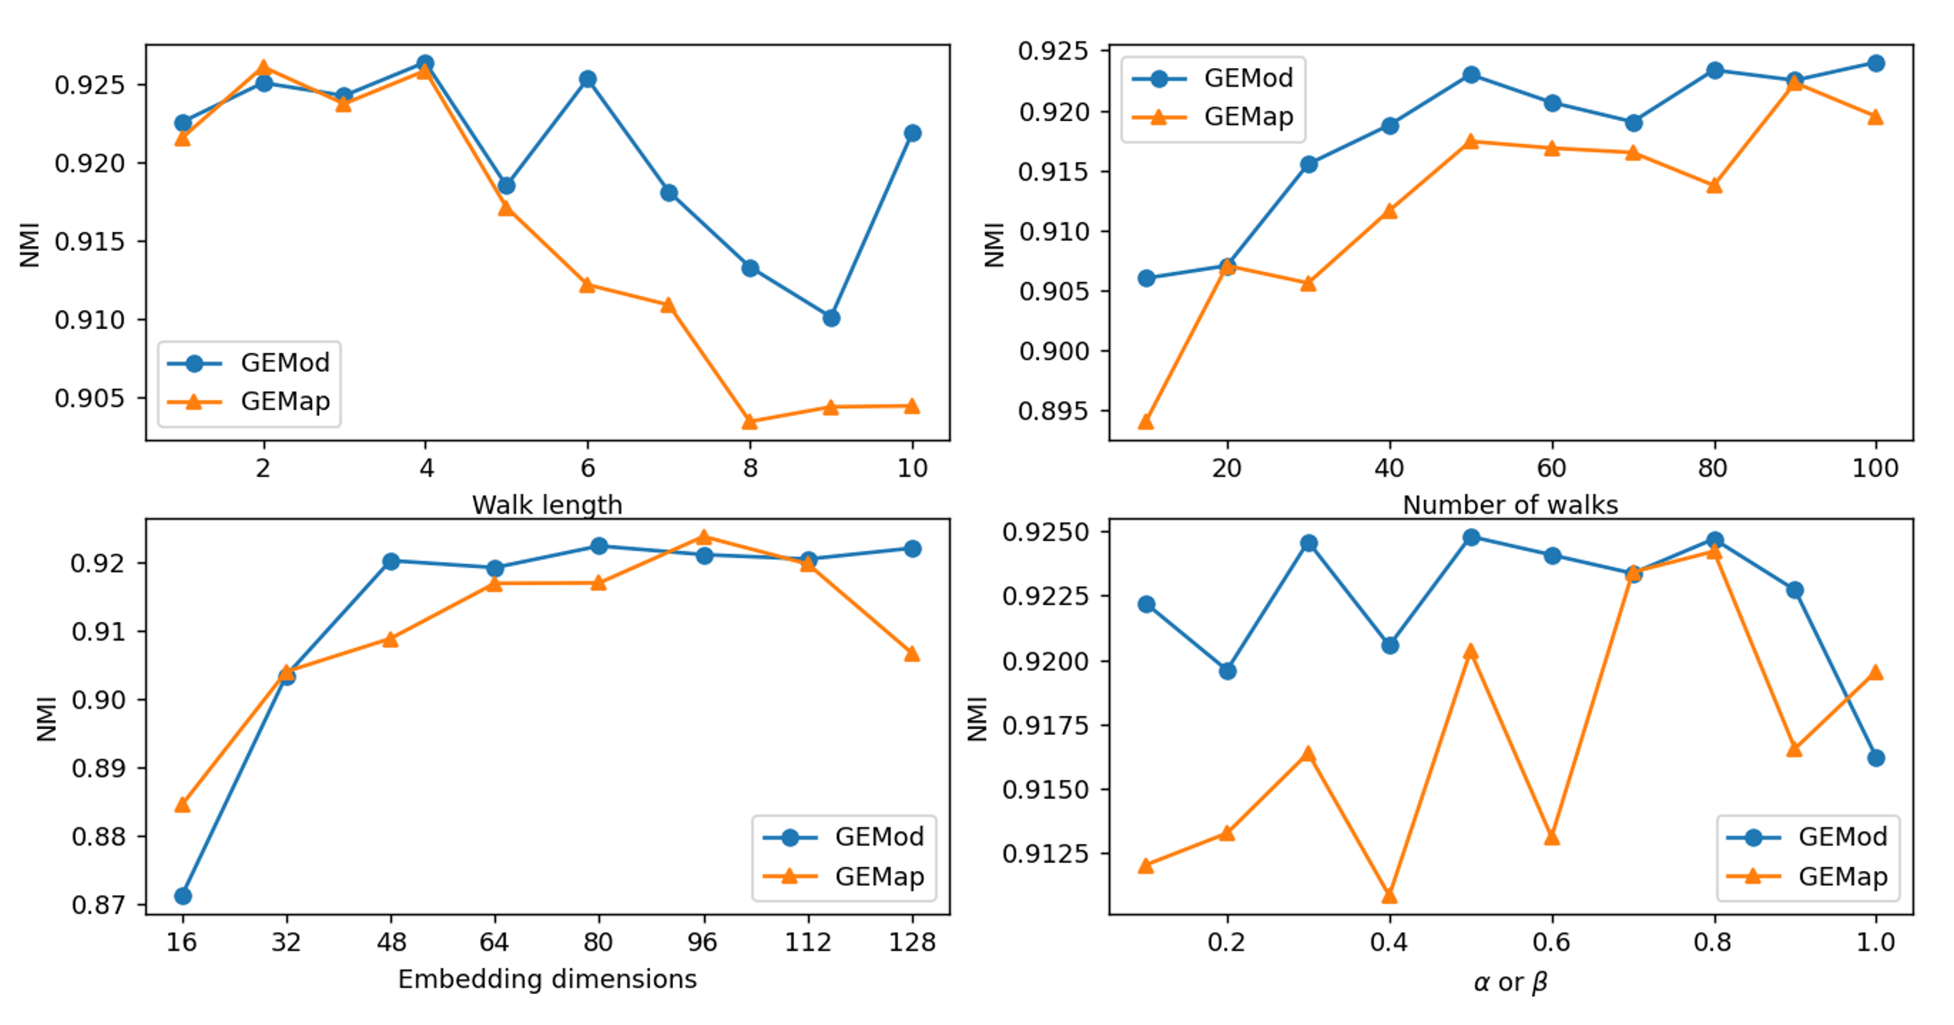
Parameters Analysis
Influence of the parameters measured by NMI on Football network

Slide 20
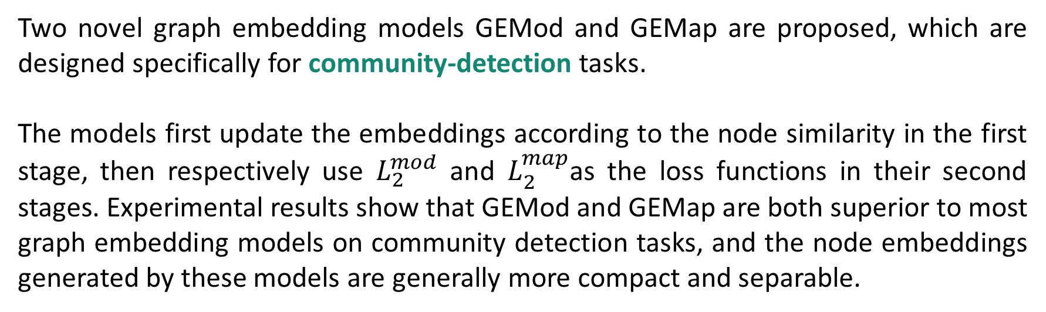
Conclusion
Two novel graph embedding models GEMod and GEMap are proposed, which are designed specifically for community-detection tasks.
The models first update the embeddings according to the node similarity in the first stage, then respectively use $L_{2}^{mod}$ and $L_{2}^{map}$as the loss functions in their second stages. Experimental results show that GEMod and GEMap are both superior to most graph embedding models on community detection tasks, and the node embeddings generated by these models are generally more compact and separable.

Slide 21
THANKS FOR YOUR WATCHING AND GUIDANCE

