Slide 1

SEKE 2022
KSIR Virtual Conference Center, Pittsburgh, USA
July 1 - 10, 2022

Slide 2
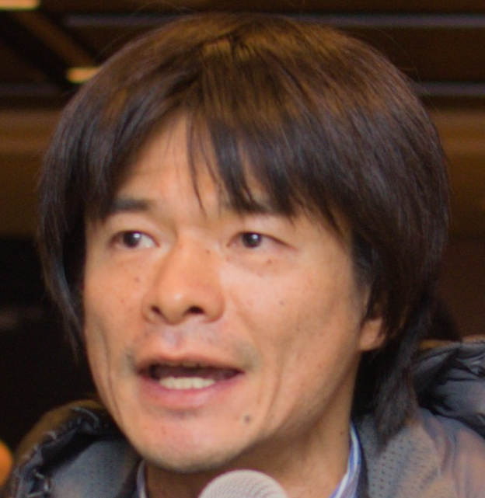
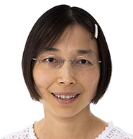
Welcome from the Conference Chairs
Kazuhiro Ogata
CONFERENCE CHAIR
JAIST
Japan
Lan Lin
CONFERENCE CO-CHAIR
Ball State University,
USA

Slide 3
Where are we?
SOFTWARE ENGINEERING
SEKE and Education
(panel July 2 8am-9am New York EST)
The Essential Structure of Software
(by Daniel Jackson, July 1 8:10am-9:00am New York EST)
Conceptual Software and Quantum Software
(panel, July 1 9:00am-9:40am New York EST)
KNOWLEDGE ENGINEERING

Slide 4
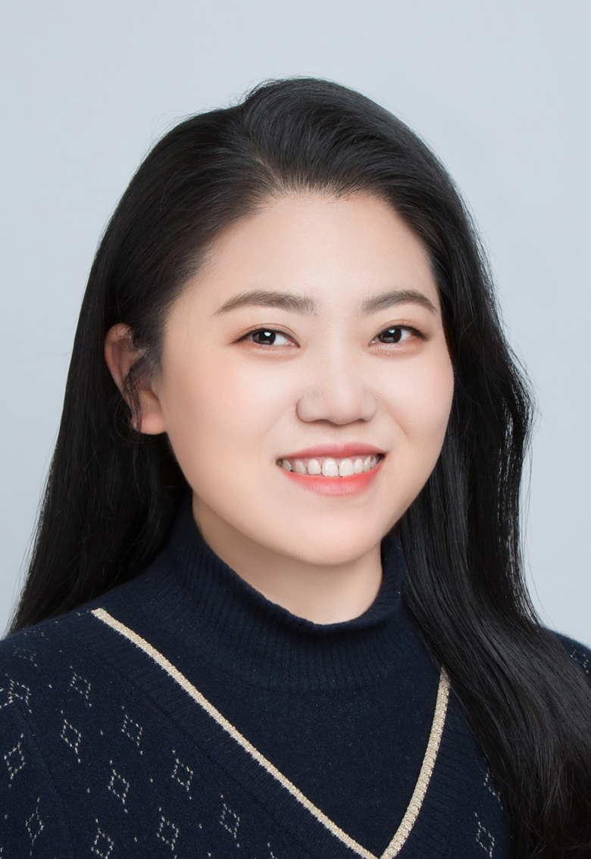
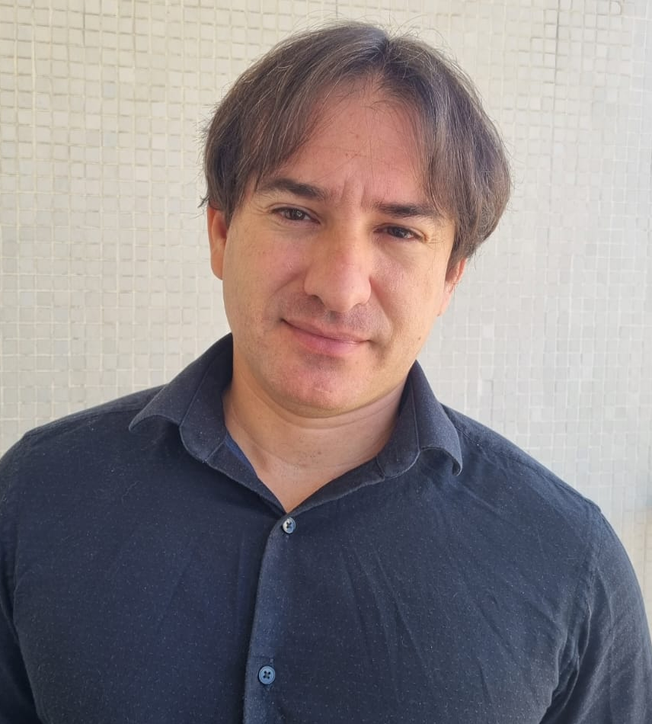
Welcome from the Program Committee Chairs
Rong Peng
PC CHAIR
Wuhan University
China
Carlos E. Pantoja
PC CO-CHAIR
Federal Center for Technological Education
Brazil
Pankaj Kamthan
PC CO-CHAIR
Concordia University
Canada

Slide 5
Acceptance rates for papers
48 rejects
67 full papers
5 Demos
50 short papers

Slide 6
Diversity
If a paper has three authors such that two are from country/region A and one is from country/region B, then 0.66 is given to A and 0.33 is given to B.

Slide 7
Themes of papers

Slide 8
Acknowledgements
All authors of the papers/demos submitted to SEKE 2022
The distinguished invited keynote speaker:
Dr. Daniel Jackson (Massachusetts Institute of Technology, USA) on July 1
The distinguished panel chairs:
Dr. Iaakov Exman (Jerusalem College of Engineering, Israel) on July 1
Dr. Pankaj Kamthan (Concordia University, Canada) and Dr. Hironori Washizaki (Waseda University, Japan) on July 2
All PC members
All the other committee members, chairs, co-chairs and liaisons; especially
Dr. Shi-Kuo Chang, University of Pittsburgh, USA; Steering Committee Chair
KSI staff members

Slide 9
Final message of the welcome from PC chairs
We cordially invite you to attend and participate in the two panels, on July 1st and July 2nd, on relatively new, exciting directions at SEKE.
We very much look forward to seeing all attendees virtually!
We wish you successful presentations, very productive discussions, and great networking at SEKE 2022.

