Slide 1

SEKE 2021
KSIR Virtual Conference Center, Pittsburgh, USA
July 1 - 10, 2021

Slide 2
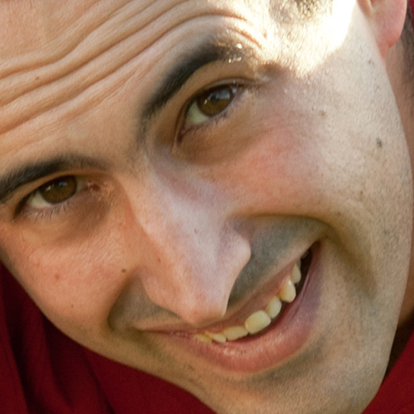
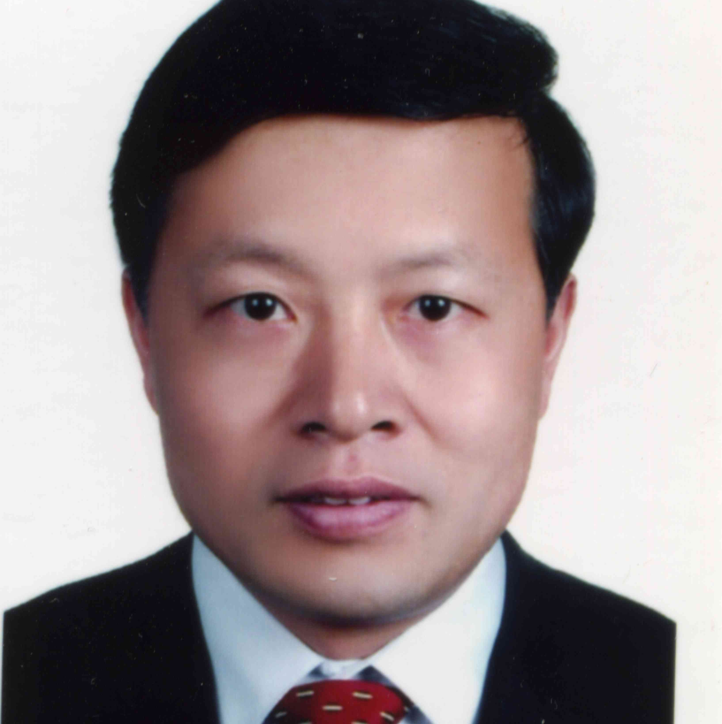
Welcome from the Conference Chairs
Raúl García-Castro
CONFERENCE CHAIR
Universidad Politécnica de Madrid
Spain
Huiqun Yu
CONFERENCE CO-CHAIR
East China University of Science and Technology
China

Slide 3
Where are we?
SOFTWARE ENGINEERING
Big data
Education
KNOWLEDGE ENGINEERING

Slide 4
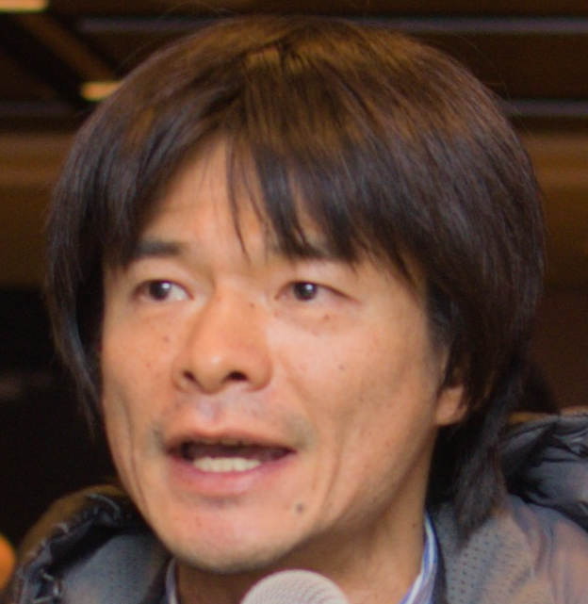
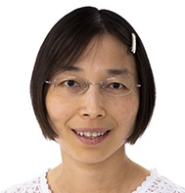
Welcome from the Program Committee Chairs
Kazuhiro Ogata
PC CHAIR
JAIST
Japan
Lan Lin
PC CO-CHAIR
Ball State University,
USA

Slide 5
Acceptance rates for papers
67 full papers
84 rejects
45 short papers

Slide 6
Diversity
If a paper has three authors such that two are from country/region A and one is from country/region B, then 0.66 is given to A and 0.33 is given to B.

Slide 7
Acknowledgements
All authors of the papers/demos submitted to SEKE 2021
The four distinguished invited speakers:
      Dr. Jeff Offutt (George Mason University, USA) on July 1
Dr. Iaakov Exman (Jerusalem College of Engineering, Israel) on July 2
Dr. Adrian Riesco (Universidad Complutense de Madrid, Spain) on July 5
Dr. Enrique Alba (University of Malaga, Spain) on July 6
All PC members
All the other committee members, chairs, co-chairs and liaisons; especially
Dr. Shi-Kuo Chang, University of Pittsburgh, USA; Steering Committee Chair
KSI staff members

Slide 8
SEKE 2021 Program
Two Keynotes
            Dr. Jeff Offutt (George Mason University, USA) on July 1
        Dr. Adrian Riesco (Universidad Complutense de Madrid, Spain) on July 5
Two Plenary talks
Dr. Iaakov Exman (Jerusalem College of Engineering, Israel) on July 2
Dr. Enrique Alba (University of Malaga, Spain) on July 6
Ten Technical Sessions
    Covering a variety of topics in SE and KE
Two Special Sessions
    Software Engineering and Knowledge Engineering Education
    Technical Demos
    One or two sessions on each day of July 1 to 10 (8:00am – 11:45am New York EST Time, 2:00pm – 5:45pm Rome Time, or 8:00pm – 11:45pm Beijing Time)
    Conference program: http://ksiresearch.org/seke/seke21.html

Slide 9
Final message of the welcome from PC chairs
We wish you have productive discussion, great networking and effective virtual presentation to participate in SEKE 2021.

